Slide 1
Module 2: TESOL – Day 4 August, 19-23, Antwerp Ms Nele Kempenaers

Slide 2
By the end of day 4 you can
See the merits of task-based learning
Use E-S-A building blocks and SMART learning goals
Teach all communication skills
Increase participation and motivation in your students
Teach vocabulary
Teach pronunciation
Teach grammar
Develop activating skills lessons

Slide 3
Over to you!
Continue to design a TBL activity to make your students familiar with the concept
Which communication skill(s) do students need to use during their task?
What follow-up study and activate activities can you already plan to further improve that skill?

Slide 4
Teaching writing skills

Slide 5
What teachers think about writing

Slide 6
Why teach writing
Students need it nowadays: work, studies, social media…
Written interaction requires register awareness
Writing is hard: it requires many subskills (and plenty of practice!)
Awareness of what is required in a finished piece of writing
(Un)reliability of Google Translate, DeepL, ChatGPT…
…

Slide 7
Guidelines
Writing as a MEANS
vs
Writing as an END
Writing for CONTENT
vs
Writing for FORM

Slide 8
What makes writing difficult?
Students are on their own
Lack of inspiration
Red-ink syndrome
No idea how to improve
Lack of time
Students lose sight of (typically long) instructions
Students can’t use tools correctly
…

Slide 9
What makes writing difficult?

Slide 10
Guidelines for teaching writing
Collaboration IN CLASS
Element of CHOICE regarding the topic and/or the use of PROMPTS
Explicitly teach the required subskills and strategies students need
Good feedback, feed forward and feed-up
Help them to turn an instruction into a checklist
Teach them how to use tools: Spellcheckplus - Thesaurus.com – Mindmup – Canva …

Slide 11
TIMESAVING TIPS
REPETITION
BE SELECTIVE
Word count?
When do you mark? (after peer- and self-assessment!)
What do you mark? (content and/or form?) 🡪 clarify writing focus!
TECHNOLOGY as your friend

Slide 13
Writing assignment incl. AI
Write an email about your teamwork skills to your manager to apply for an open internal position.
What can you do very well?
What are your skills, what can you do better than others?
What tasks are you most suited to?
What kind of tasks are you not really suited to?
Write at least 150 words. Check grammar, spelling and punctuation.
MS Word: change the language to English!

Slide 14
Stage 1: write a personal, polite (formal) email
Stage 2: have ChatGPT or Gemini check your work:
Ask to correct your work
Ask to spell check your work
Ask to rewrite your work
Ask to expand your work
…
Stage 3: “reverse engineer”
COMPARE the computer’s work to your work: what did it do better? Which RULES for being polite did it apply?
Stage 4: Which email would you send? Why?

Slide 15
As always: take student differences into account
Amount of pre-teaching
Group work
Text length
Guidance on final form
Time available?

Slide 16
Mind the traps!
Writing is NOT effortless, NOT always homework
Feedback/feed forward not only after writing – avoid red pen syndrome
No readers?!
No differentiation?
Not another email…

Slide 17
WRITING ACTIVITIES (mainly for fluency)
Variation is KEY

Slide 18
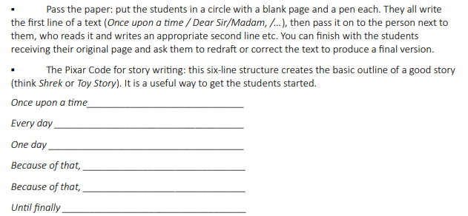
WRITING ACTIVITIES (mainly for fluency)

Slide 19
WRITING ACTIVITIES (mainly for fluency)

Slide 20
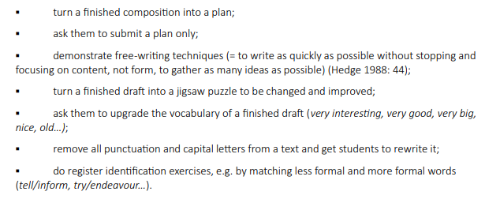
Explicitly teach subskills

Slide 21
Pre-while-post
PRE-WRITING: PREPARATION AND PLANNING
→ maximum student input: content & ideas
→ model text analysis
text purpose? reader?
WHILE WRITING
checklist!
use of tools: what is allowed/necessary/…

Slide 22
POST-WRITING
feedback, feed-up, feed forward
Peer assessment
Self-reflection
Focus on content?
Focus on form?
🡪 Revising and rewriting = essential!

Slide 23
TASK-BASED WRITING
Surveys
Telephone messages
Job applications
Complaints
…
Deep end approach ☺

Slide 24
Where to find (remedial) material?
https://learnenglishteens.britishcouncil.org/skills/writing
https://www.bbc.co.uk/bitesize/topics/z43dwnb

Slide 25
Teaching vocabulary

Slide 26
BASICS
Select
Explain flexibly
Practise, learn, store, use and recycle
Master the vocabulary you teach
Vary and repeat

Slide 27
1. How do you select vocabulary
Teach words that are easy to teach and can be explained easily
Teach words that learners may need for an upcoming activity
Teach words that learners ask about and want to know
Teach words that learners will find useful in their daily lives
Teach words that are very frequent in English
Teach the words that appear in the learners’ course book

Slide 28
Checklist:
Coursebook?
Pupils’ needs?
Vocabulary lesson or skills lesson?
Receptive and/or productive knowledge required?
frequency:
Corpora e.g. http://www.natcorp.ox.ac.uk/
difficulty:
Text Analyzer - Find the CEFR level of texts from CEFRlevels.com

Slide 29
Remember: you are NOT a walking dictionary
STRATEGIES!
Guessing from context
Developing reference skills
Vocabulary records?
Demonstrating and discussing ways of memorizing vocabulary

Slide 30
Practise, learn, store, use and recycle

Slide 31
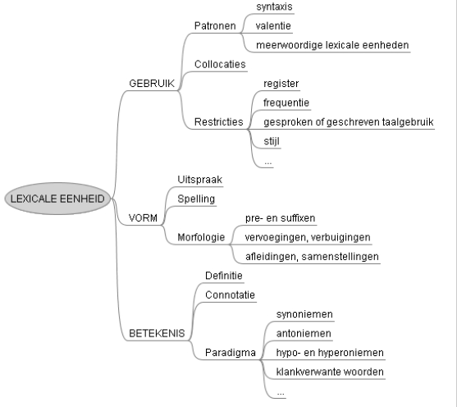
Vocabulary =
USE
FORM
MEANING
Collocations
Restrictions in use
Grammatical information

Slide 32
Good vocabulary exercises are…
Authentic
Useful/functional
Not too easy/difficult
Timed right
Combinations of meaning, form and/or use
Focused on strategies
Motivating the pupils
* lay-out

Slide 33
Example exercises

Slide 34
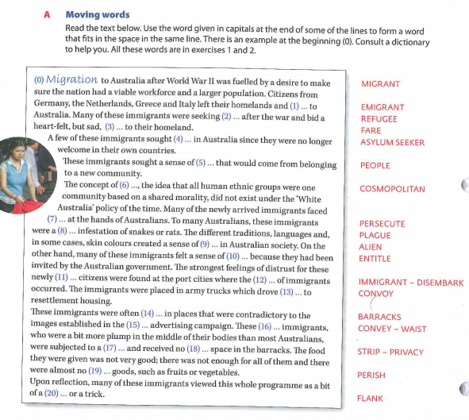
Spark 5

Slide 35
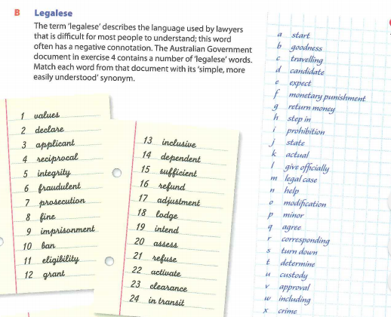

Slide 36
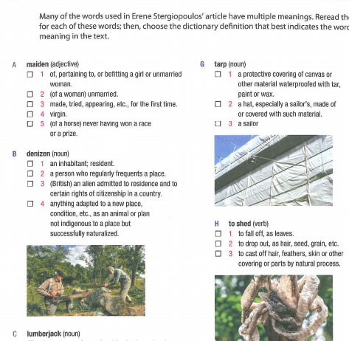

Slide 38
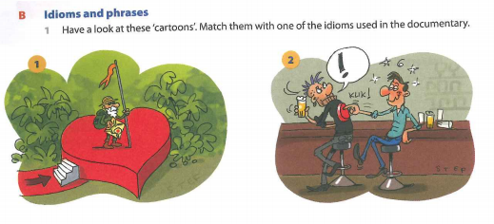
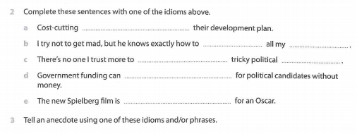

Slide 39
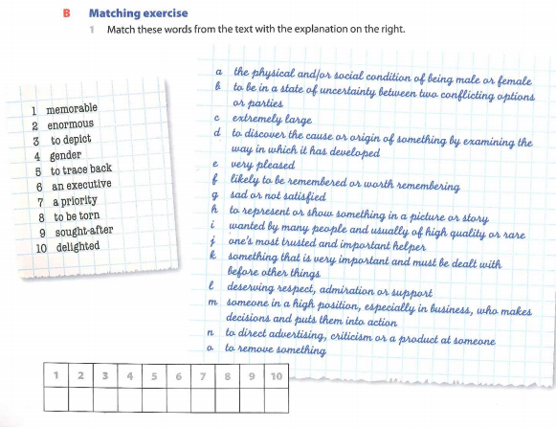

Slide 40
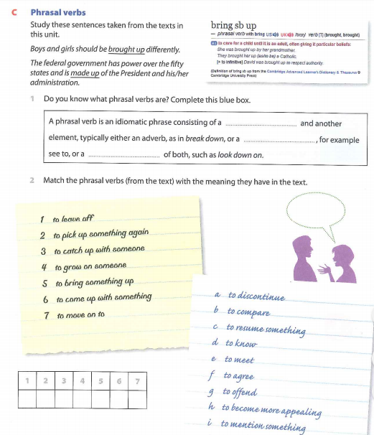

Slide 41
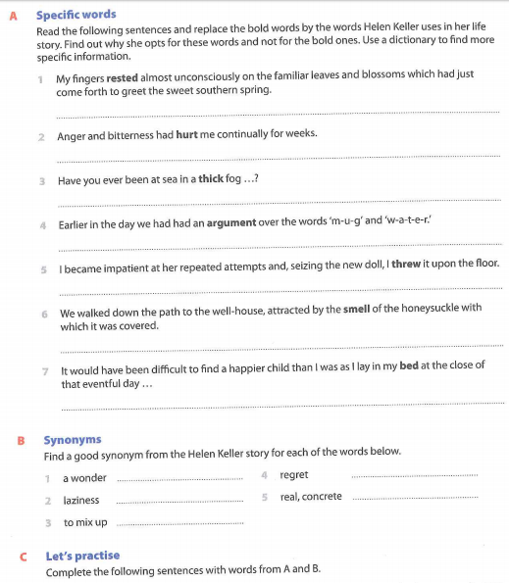
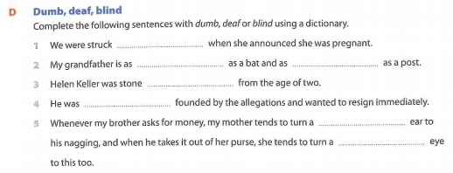

Slide 42
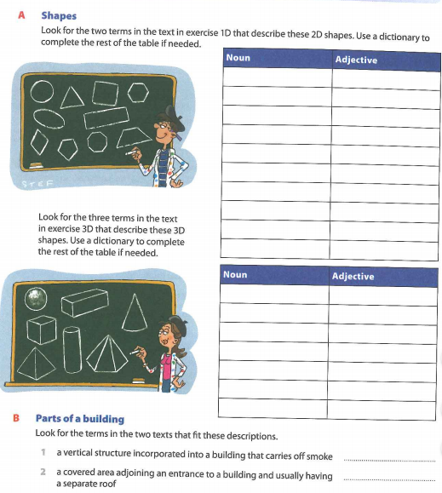
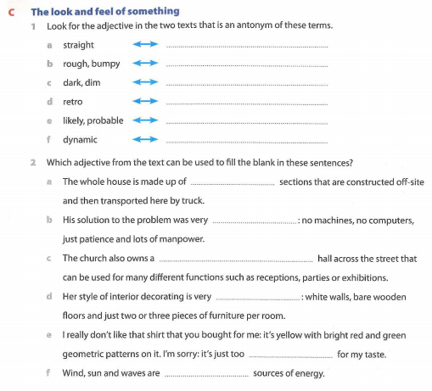

Slide 43
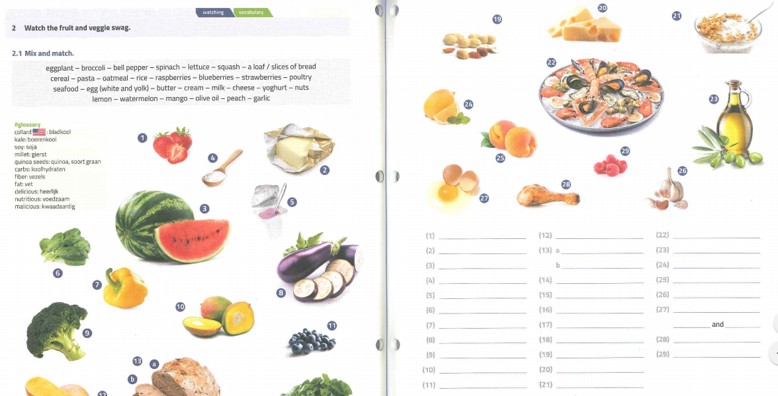
Connect 2

Slide 44
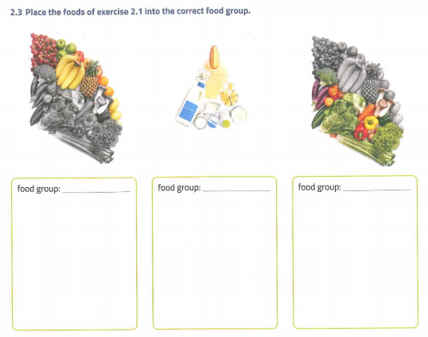

Slide 45
Vocabulary exercises

Slide 46
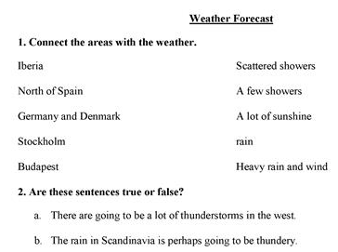
1. Recognising the words
Noticing (lay-out!)
Tick off the words you hear
True or false?
Matching
Multiple choice
Gap-fill with options given
…

Slide 50
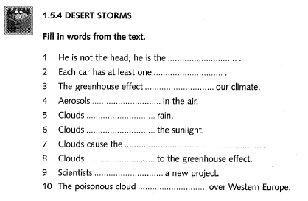
2. Producing the words
Gap-fill
Short answer questions
Speaking exercises (discussions, games…)
Writing exercises (notes, comments, tweets…)
…

Slide 52
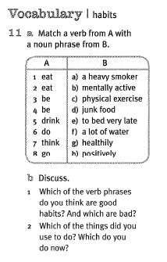
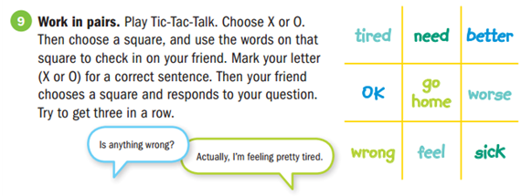

Slide 53
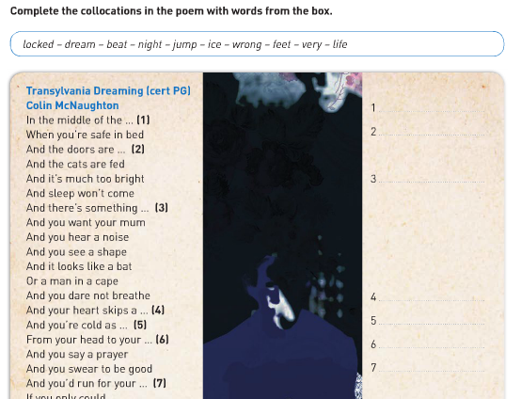
Focus on form
Pronunciation → rhyme → intonation/stress patterns

Slide 54
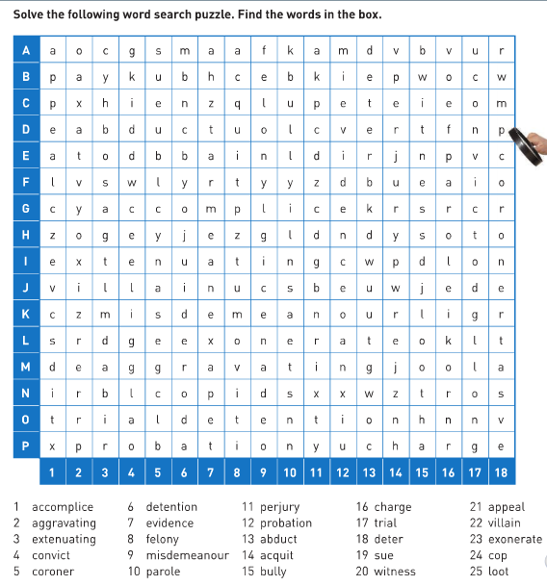
Focus on form
Spelling → missing letters → write down the words you hear… → hangman → unscrambling words* → wordsearches* → crossword puzzles*

Slide 55
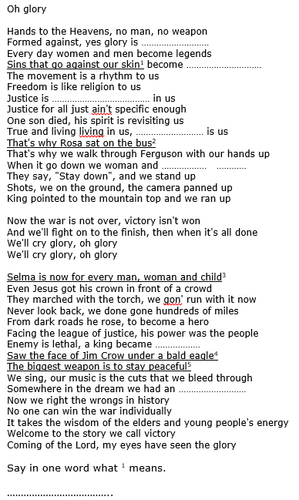
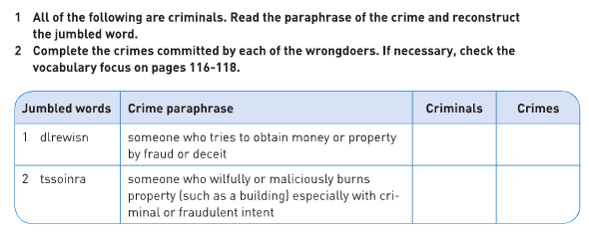

Slide 56
Focus on form
Morphology
Verb forms
Derivations
Compound nouns
Pre- and suffixes (domino, matching …)
Choosing the correct option based on the context
…

Slide 57
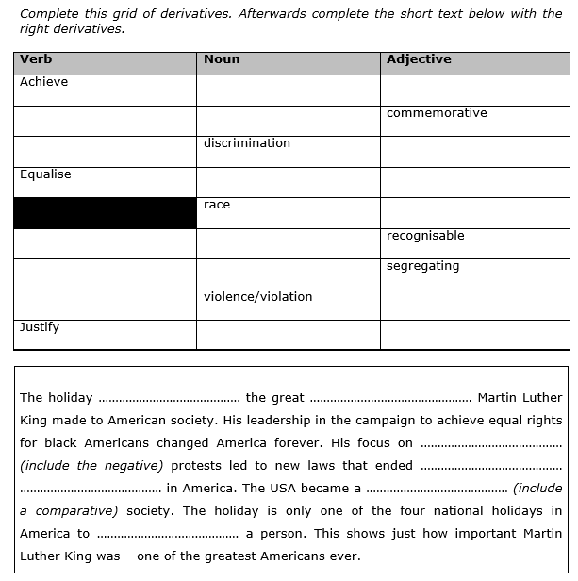

Slide 58
Focus on meaning
Matching: definitions, illustrations…
Crossword puzzles, taboo, literal ⬄ figurative meaning, connotations
Brainstorm, association exercises
Synonyms, antonyms
Find the odd one out
Grouping exercises: hyponyms, hypernyms, mindmaps (https://www.mindmup.com/ )
Words that look alike, false friends (I always get my sin)

Slide 59
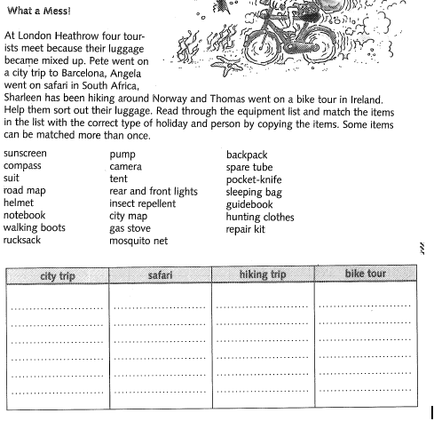

Slide 60
Focus on use
Word patterns (-ing or infinitive, position of adverbs…)
Collocations
Phrasal verbs
Restrictions and constraints
Formal/informal
Spoken/written
Dialect

Slide 61
Recycling, reusing… activating?
Upcycle textbook materials:
Matching → memory game, find your match, crossword…
Fill-in exercises → A/B exercises (information gap!)
Find in the text → competition/race
Complete the table → post-it race
Complete the text → now make it funny/sad/unrealistic… using opposites/rhymewords…

Slide 62
Vocabulary games
I go on holiday/shopping/… and I bring/pack/buy…
KIM (one item disappears)
Mime
Total physical response (head, shoulders, knees and toes…)
Scrabble
Who/what is it?
Happy families
…

Slide 63
Ideas on how to improve…?

Slide 64
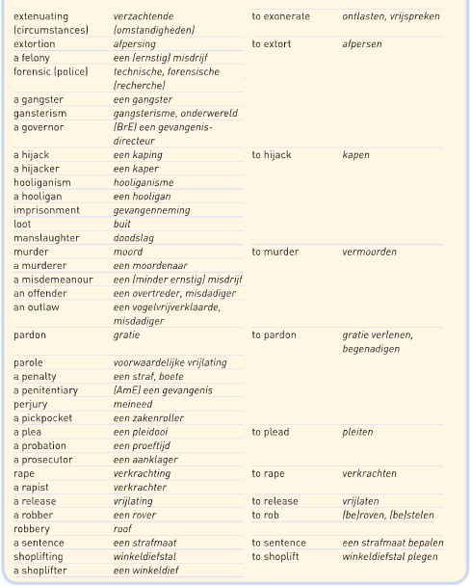

Slide 65
How to make vocabulary exercises…
EASIER
Pairwork?
Not too many gaps
CLEAR contexts
Example/options given
CLEAR layout
→ Avoid guesswork

Slide 66
How to make vocabulary exercises…
TRICKIER
Change the expected instruction (opposites, two answers for each gap…)
Provide many example sentences with the same word missing
Provide the root form of the word
Look for chunks/collocations

Slide 67
How to make vocabulary exercises…
REALLY GOOD
Use authentic language & materials
Focus on collocations (preferably ready-to-use, frequent language)
Clear instructions & layout
Maximise recycling

Slide 69
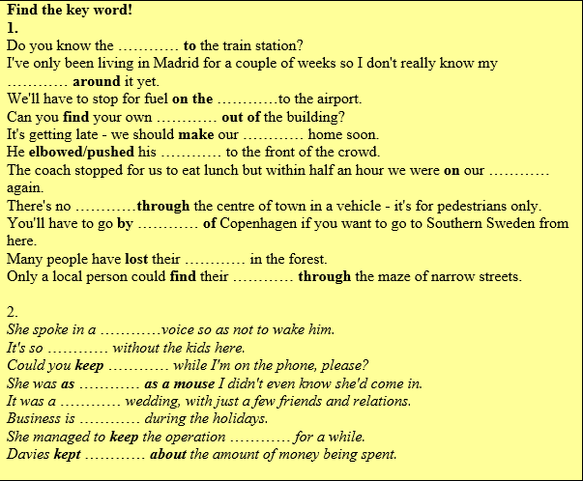

Slide 70
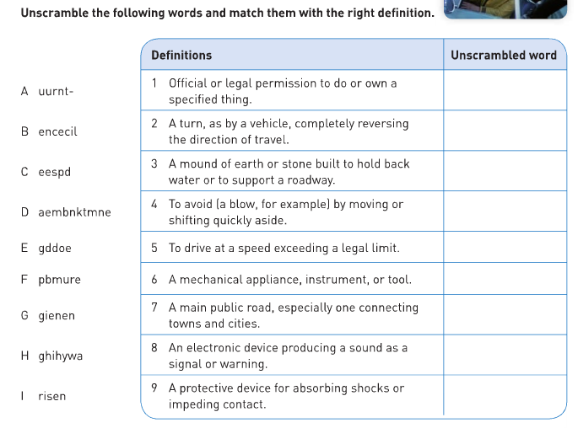
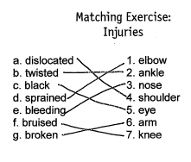
Clarity
1 instruction?
Easy to redo?
Feasible?
No guesswork please!
Font, spacing…

Slide 71
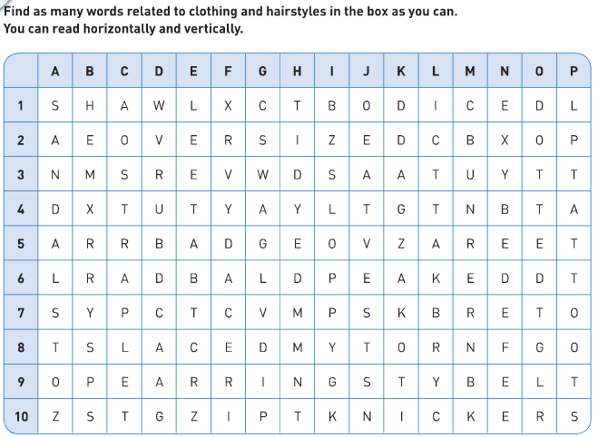

Slide 73
Make students learn more vocabulary
Encourage them to systematically notice lexical items → vocabulary diary, collectable words pages, portfolio work…
Revisit word pages & add to them: collocations, examples…
Integrate vocabulary in your corrective feedback
Challenge pupils to upgrade their language
Encourage them to deal with unfamiliar vocabulary in texts – crucial or ignore?
Teach them with / about online tools
Brainstorm & elaborate

Slide 74
Teaching pronunciation

Slide 75
Learning to pronounce the language in a clear way is a very important learning goal. Clear pronunciation will help you to be better understood by [other] English speakers. (Paul Nation)
The English language has 44 phonemes, whereas the average language has 35. Phonemes that do not exist in learners' mother tongue(s) are automatically challenging and worth teaching.
English is different. A single sound may take a dozen or more forms when written down.

Slide 77
When students mispronounce a word, getting them to produce the correct word stress can be one of the fastest ways to improve intelligibility. (John Hughes)
Typical features of connected speech where English 'eats' sounds, unstressed syllables and 'weak' forms:
Bread 'n butter (elision)
I /j/ always do (intrusion)
Linking the final consonant and the initial vowel
Teaching students how to use their mouth, tongue, throat and voice (articulatory phonetics) helps them produce the sounds of English. (Jennifer Lowe)

Slide 78
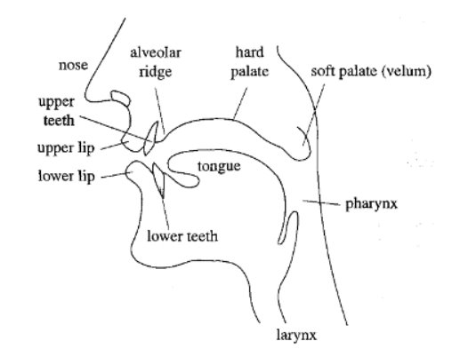
How to teach pronunciation
Try to get it right from the start
A useful guide is 'a little and often'
Provide some background noise while they practise (safe environment)
Provide plenty of low-pressure activities for deliberate practice
Encourage students to be authentic – it is natural to retain some L1 influence (Dudley)

Slide 79
TIPS
Master the pronunciation you are teaching. Or show a master at work, e.g. Pronunciation skills with Adrian Underhill (youtube)
Find out what the difficult sounds are, then practise them in a contrastive way. Three - Tree
Choral drilling makes learners feel safe. Give learners the opportunity to repeat/imitate several times

Slide 80
TIPS
Do not blend pronunciation and skills practice. It is very hard to focus on reading comprehension while trying to get pronunciation right.
Encourage students to practise pronunciation on their own with free resources for self-study:
Learn English sounds right (British Council)
Sounds: the pronunciation app (Macmillan)
BBC Learning English - Pronunciation
...

Slide 81
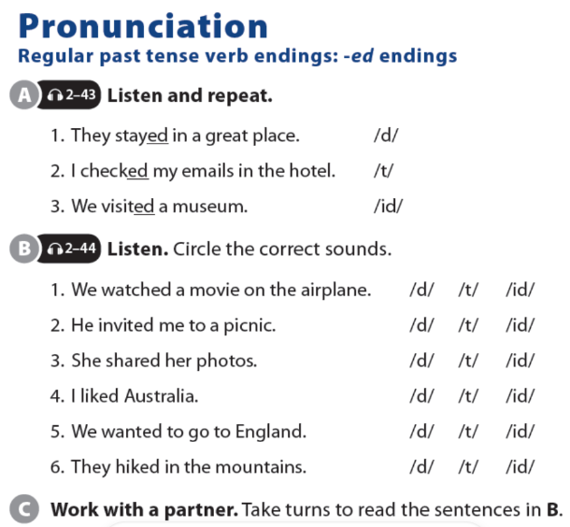
Make pronunciation visual and conscious
An 'e' at the end of the word makes the vowel say its name
Pronunciation of '-ed'

Slide 83
Have you tried voice typing?
https://ddeubel.edublogs.org/2018/10/24/voice-typing-for-student-story-retelling/

Slide 84
Teaching grammar

Slide 85
What is grammar to you?

Slide 86
Create expectations
Do not make it look like grammar.
Work with authentic materials to introduce the grammar OR set your pupils a challenge which they need the new grammar for.
Do not spend too much time on ‘presentation’ 🡪 push, activate, encourage and help pupils to practise as much as possible.

Slide 87
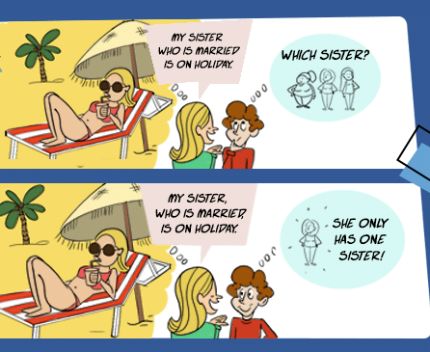
Teacher explanations
Keep it clear and simple: stepwise!
Keep it accurate and helpful
Prepare: structures, diagrams, examples
Too much detail will cause confusion
Short and focused explanation
Think how the grammar can be put to meaningful use
Think of when you will give which information

Slide 88
Variation
Exercises
Games
Skills
ALSO when correcting
Knowledge 🡺 transfer 🡺 communication
* Appropriacy: age, level, needs, group size, interests, expectations…*
* The same textbook exercise can be done in many different ways*
* Personalise *

Slide 89
FORM
MEANING
USE
‘conceptuele kennis’
‘procedurele kennis’

Slide 90
Poll:
Which approach is best?
A: inductive approach
B: deductive approach

Slide 91
FUNCTIONAL
FUN
TASK-BASED
Not a goal in itself!
So many grammar games… to MOTIVATE your learners and encourage PARTICIPATION
Correct grammar is necessary to accomplish a communicative task
BITESIZE
CONTEXT
DIFFERENTIATION
Less is more… time to practice
Communication is key: when and where is this used/useful?
…as always… try to take differences between students into account

Slide 94
Can you think of a goal-oriented task for:
Future tenses

Slide 95
Thornbury’s rules of thumb
The RULE of CONTEXT: teach grammar in context, grammatical forms have meaning.
The RULE of USE: always provide opportunities for learners to put the grammar to some communicative use.
The RULE of ECONOMY: economise on presentation to provide maximum practice time. ‘A little can go a long way.’
The RULE of RELEVANCE: find out what they already know & exploit common ground
The RULE of NURTURE: provide the right conditions for learning
The RULE of APPROPRIACY: learner level, needs, interests & expectations

Slide 96
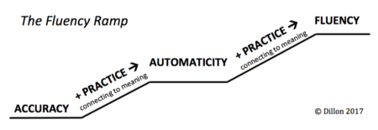
From accuracy to fluency

Slide 97
Over to you! (again)

Slide 98
Over to you!
Develop another SKILLS lesson for your students, in which you put at least 3 tips you want to remember from this week’s CPD.
(Your homework by November)
Use the template for easy dissemination.

Slide 99
Digital tools to use in the classroom
Kahoot
Wooclap
Classkick
Mentimeter
Socrative
Nearpod
https://whiteboard.fi/
https://www.eu.whiteboard.chat/
11 formative assessment tools
Jeopardylabs
https://classroomscreen.com/
Free online word games
ESLGamesworld
https://app.wizer.me/
https://screenpal.com/

Slide 100
Tools and websites
Onestopenglish.com
British Council
BBC learning English
Linguahouse
https://eslexpertz.com/
ReadTheory
https://www.thesaurus.com/
Spellcheckplus
https://www.canva.com/en/
https://www.mindmup.com/

Slide 101
Continued CPD
https://educationendowmentfoundation.org.uk/
https://www.teachingenglish.org.uk/
https://teachingenglishwithoxford.oup.com/
https://webinars.eltngl.com/
https://www.theteachertoolkit.com/

Slide 102
Sharing is caring

