Slide 1
Module 2: TESOL – Day 3 August, 19-23, Antwerp Ms Nele Kempenaers

Slide 2
By the end of day 3 you can
See the merits of task-based learning
Identify and juggle the E-S-A building blocks
Formulate SMART learning goals
Come up with your own task-based lesson idea(s)
Teach communication skills (general guidelines)
Increase participation and motivation in your students
Teach listening skills
Teach reading skills
Teach speaking skills
Teach writing skills

Slide 3
Over to you!
Continue to design a TBL activity to make your students familiar with the concept
Which other communication skill(s) do students need to use during this lesson?
Can you further increase participation and motivation?

Slide 4
Teaching listening skills

Slide 5
Let’s do the Dutch reach!
https://www.youtube.com/watch?v=WeM984dk220

Slide 6
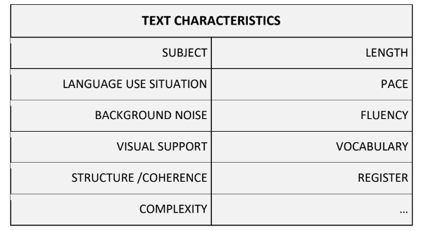
Exploration assignment

Slide 7
Reasons for teaching listening?
to explore different varieties and accents
to realize the value of listening
to acquire language subconsciously
to learn to listen for a variety of purposes
to practise an academic skill

Slide 8
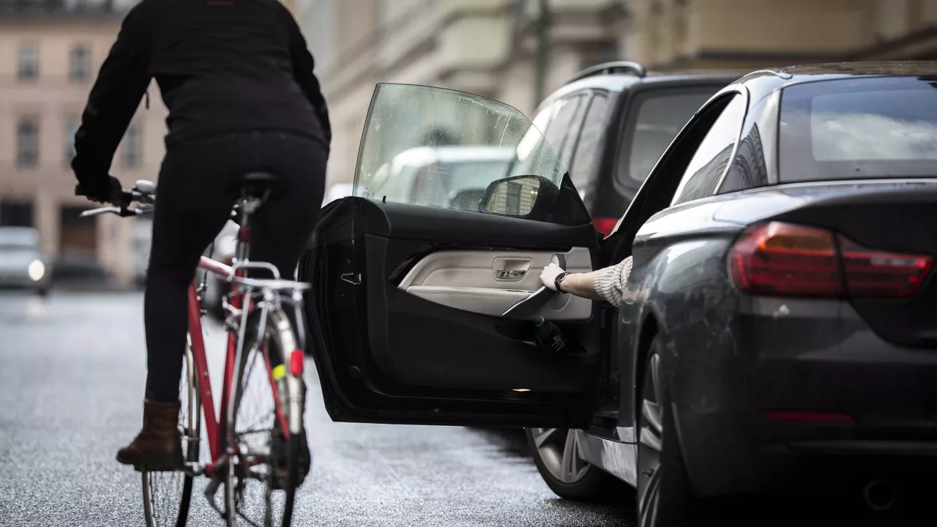
Let’s do the Dutch reach!

Slide 9
Let’s do the Dutch reach!
How do you open the car door when you get out of the car?
Do you always check for other traffic users/obstacles?
Have you ever cycled into an opening car door?
What happens to the cyclist when a car door suddenly opens?

Slide 10
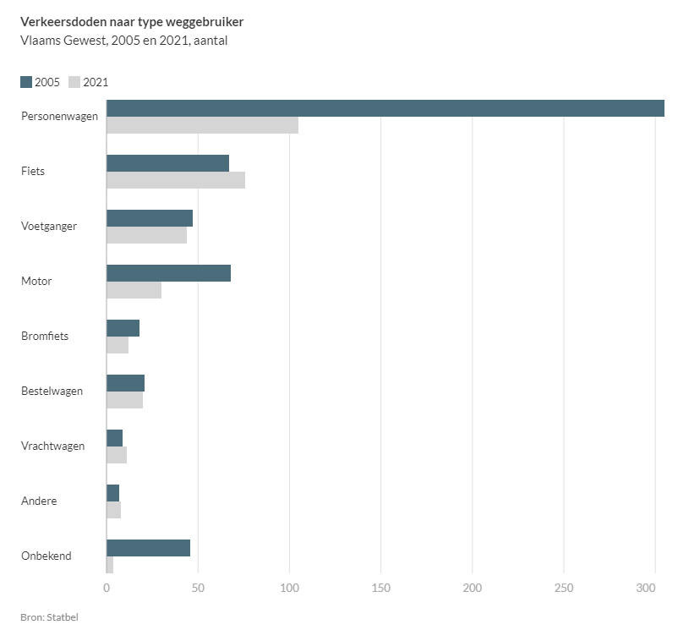
Let’s do the Dutch reach!

Slide 12
Guidelines for teaching listening
Tips and tricks:
promote student interaction
differentiation
listening rounds
video vs audio
pre, while and post
vary listening activities

Slide 14
Listening rounds
Round 1
main information
one specific piece of information
Subsequent rounds
more specific information
specific language
listening strategies: using context to understand etc.
Always from GLOBAL to SPECIFIC.
Never listen with the transcript in the first round!

Slide 15
Pre-while-post
Pre
→ maximum student input
→ predictions
→ ? essential vocabulary?
While
→ all kinds of questions
→ NOT TOO MUCH WRITING
Post
→ student interaction with text materials and each other, reflection

Slide 16
Question types
Listening for gist
→ 1 question!
e.g. Where do these friends decide to go this evening?
e.g. What is the speaker’s main aim? A) to inform; B) to describe; C) to convince
e.g. Put these 4 points of discussion in the correct order.

Slide 17
Question types
Listening for specific information
True/false/NIT - MCQ - Yes/NO - Fill in the blanks…
→ Complete the table with the missing numbers.
→ Listen for these numbers. Write down what they refer to.
→ Write notes about each of these main points: how stars are made, the sun, the Milky Way…

Slide 18
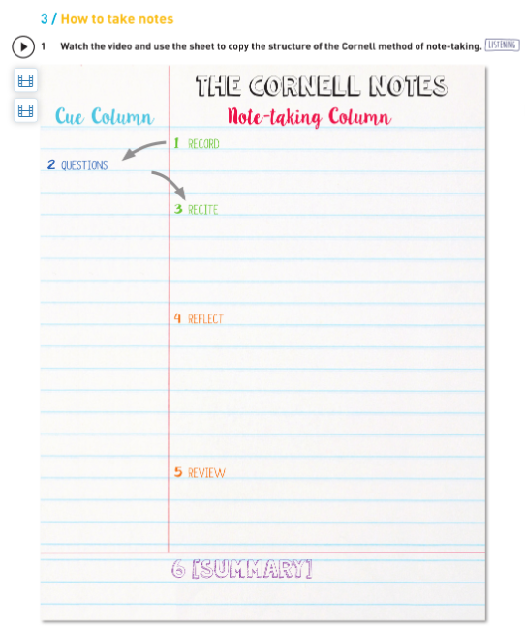
Track ‘n Trace 6, p83

Slide 19
Question types
Listening for specific (functional) language
→ Tick the phrase(s) you hear.
→ Write the phrase you hear.
Gap-filling:
limit the number of gaps / the amount of writing
provide enough words before the gap
? let students predict/guess first?

Slide 20
Track ‘n Trace 6 p185

Slide 21
Where to find (remedial) material?
https://edpuzzle.com: collection of interactive video lessons
https://engelsklaslokaal.nl/kijk-en-luistervaardigheid-engels/: TED talks with questions
https://www.youtube.com/asapscience The channel produces weekly videos that touch on many different topics of science. Fun, fast, nice visuals.
https://www.vrt.be/vrtnws/en/ The vrt news in English.
https://www.bbc.co.uk/learningenglish/english/features/6-minute-english 6 minute podcasts + useful vocabulary on the topic. Remedial exercises.
https://www.cristinacabal.com/?p=9147: 10 Best Free Listening Websites with Quizzes to Practise for Listening Exams

Slide 22
Teaching reading

Slide 23
Introduction
Practising vs teaching
→ Awareness of HOW

Slide 24
Reading skills
The process of reading: constructing meaning for a reason
Developing reading skills: strategies
scanning vs skimming
extensive vs intensive reading
Questions to help reach a depth of understanding (Broughton)

Slide 25
1. Scanning
specific information, details
ALL levels of proficiency
How?
set a time limit
‘find the names / dates / departure time / location / …’
‘find the sentence with the word … in it’

Slide 26
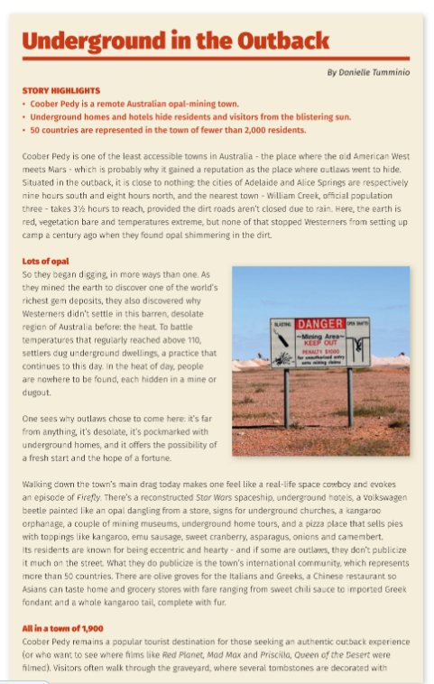
Answer these questions within 5 minutes
1.Which continent is it?
2.What are the dangers?
3.How many inhabitants are there?
4.What is the temperature?
5.What is special about the homes?
6.What do they mine?
7.What is fossicking?
8.How can you get there?
9.EXTRA: What is the fastest and safest way to get there?
(On Track 6, p15-17)

Slide 27
2. Skimming (reading for gist)
main ideas
ALL levels of proficiency
How?
Which type of text is this?
Add a subtitle for each paragraph.
‘Find the sentence that tells us that …’
‘Summarise the text in your own words in 1 minute / 5 sentences’

Slide 28
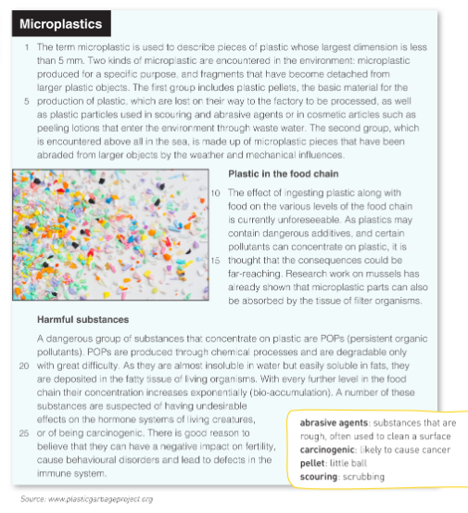
Are microplastics a threat to our planet?
Highlight in the text where you found
the answer.
What are microplastics?
Look for the topic sentence in each paragraph. Where is it usually situated?
(Track ‘n Trace 5, p136-137)

Slide 29
3. Extensive reading
for pleasure
mostly for (pre-)intermediate - advanced learners
How?
WH-questions: who, what, when, where, why, how?
see also: Teaching literature (course shared via email)

Slide 30
3. Extensive reading
JIGSAW reading
Select different texts / cut a text into different parts -- mark it with a number and a colour or symbol (1-2-3-4, yellow-blue-white-green ...)
2. Hand out a text (part) to different students
3. Students read their text individually
4. Students who read the same text discuss in pairs/small groups
5. Make new groups of students so that they can exchange what they have read

Slide 31
4. Intensive reading
for detailed comprehension
upper levels of comprehension/proficiency
How?
Why did the author use…?
Which elements are typical of …?
Respond to the author’s point of view…
Continue the story…
….

Slide 32
Staging a reading lesson
TYPICALLY:
Pre-reading: activate knowledge, trigger an interest, purpose
While-reading: questions/strategies
Post-reading: (self-)reflection on reading process/text content

Slide 33
Staging a reading lesson
? Diving in at the deep end?
→ defining your own reading goal, strategies etc. is a valuable skill
ALWAYS
set a timeline
provide an activity to be done when ready (DIFFERENTIATION)
have a follow-up activity

Slide 34
Reasons for teaching reading?
academic, professional and/or business needs
helps language acquisition
helps writing skills
inspiration for free communication
…

Slide 35
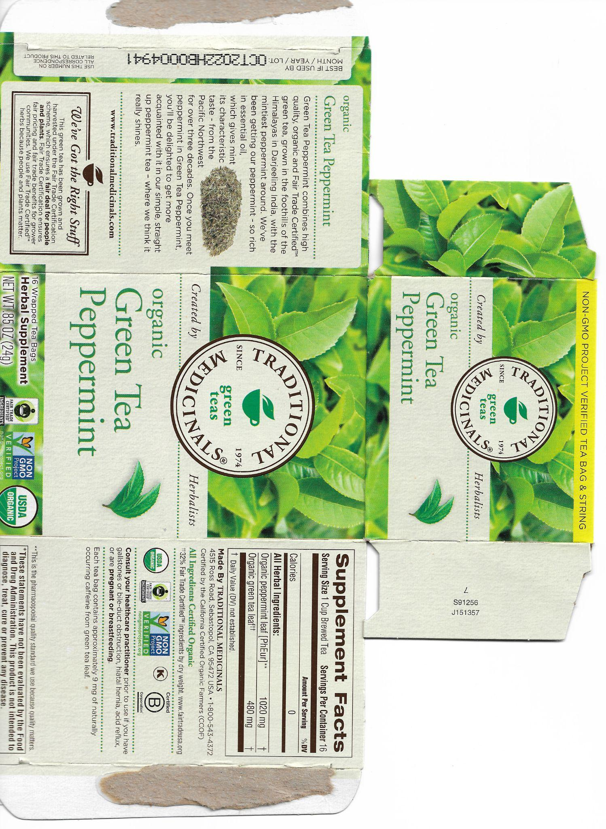
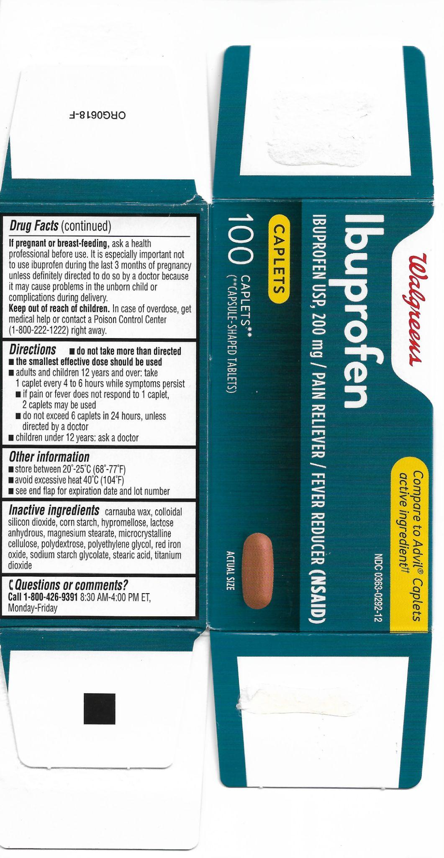
Materials for reading

Slide 36
Materials for reading
Select carefully:
different text types
authentic reading materials
relevant reading materials
Internet = treasure trove! graphs, signs, recipes, timetables…
TIP: Online quizzes/surveys/tutorials/… are motivating & instructive ;)

Slide 37
Making texts reader-friendly

Slide 38
Making texts reader-friendly
NO:
students do not need to understand everything
adapt your questions, not the text
a challenge is healthy
groupwork? jigsaw reading?
…
Mind the Zone of Proximal Development, though: CEFR Text Inspector (BB)
More than 5 incomprehensible words per page is demotivating…

Slide 39
Making texts reader-friendly
YES:
Universal Design for Learning: make the text more accessible
students need to understand most of it
too much of a challenge is demotivating
ADAPT PRESENTATION
font, size, pictures, line numbers, spacing…
ADAPT CONTENT
delete, substitute, rewrite

Slide 40
ADD
glossary
vocabulary list
? Which words? → CEFR vocabulary profiler (BB)
Pre-teach vocabulary?

Slide 41
ETpedia Materials Writing p69

Slide 42
Making texts reader-friendly
VARIATION is key

Slide 43
Teaching speaking/spoken interaction

Slide 45
“Every opportunity for speaking in the classroom should be taken.”
Jim Scrivener

Slide 47
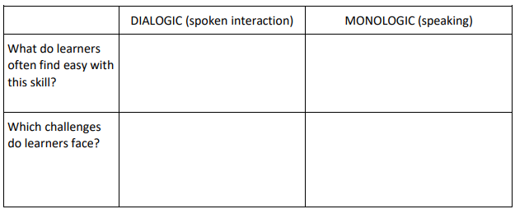

Slide 48
Safe environment = key!

Slide 50
Carefully plan speaking activities
Why are students doing this?
Who is the audience?
Focus on accuracy or fluency?
Knowledge needed?
Scaffolding needed?
TIMING!
Feedback: when? How?

Slide 51
Example: how would you plan?
That awkward moment…
Look at these pictures of “awkward moments”.
Have you ever been in an awkward situation?
What happened?
How did you feel?

Slide 52
While speaking
Time to practise!
Coaching – checklists – student roles - …
Grouping: student talking time
Classroom arrangements

Slide 53
What if… students have nothing to say?
Safe environment?
Clear instructions? Provided a model?
Student interest?
Is there a NEED to speak? (motivation!)
Do they have the necessary language at their fingertips?
Have they had some THINKING TIME?
Is the activity well-managed, so not one or two students are talking all the time?
*buzz groups?*

Slide 54
After the speaking activity
ALWAYS leave room for (peer) feedback & (self-)reflection
Feedback rules of thumb:
Stress the positive aspects!
Focus on problems common to the group
How can students do better next time?
Strategy use
Extra accuracy/fluency practice
Pronunciation practice
…
Do the speaking activity AGAIN (how else do they learn?)

Slide 55
Developing dialogic speaking skills
Different stages:
half a dialogue 🡪 skeleton dialogue 🡪 general input
Routine ⬄ unpredictable
14 themes (CEFR) – learner-centred content: personal identiﬁcation; house and home, environment; daily life; free time, entertainment; travel; relations with other people; health and body care; education; shopping; food and drink; services; places; language; weather
Topic- versus task-based speaking
Strategies!

Slide 56
Example 1 - speaking cards
We talked about this a few weeks ago. This is my ‘go to’ speaking activity, it boosts:
Creativity
Cooperation between pupils
Everyone can pitch in, it’s a ‘low threshold’ kind of exercise
It can be adapted to suit all levels (scaffolding)

Slide 57
Emotions and Expressions
Speaking: Conversation class
Notes:
https://captiongenerator.com/1544462/Conversation-class

Slide 58
You’re going to get a few cards …
Task:
Work in pairs.
Discuss the cards you are given.
Create a story using the cards.
Speak in English only.
Do not write anything down, except for keywords if you need to.
When I come to your table, show me your favorite cards and tell me your story. You can repeat what you've talked about, or start a new conversation with me.

Slide 59
The 4 rules for conversation class
Rule 1: Even if you’re struggling, keep going! Don’t give up!
Rule 2: Rely on each other first. I will be walking around, I’ll come to your table
Rule 3: Keep speaking/going until you hear the bell.
The timer will be set for 5 minutes each round
Rule 4: I can veto your pair. I’d like you to learn, so deciding who you work with is very important.

Slide 60
Which emotions and expressions can I expect to see?
Emotion keywords:
Happy
Sad
Angry
Love
Scared
Dislike
Worry
Surprised
Shocked
Pleased
Confused
Fed up
Are they VERY happy, sad, etc?
Or are they ‘just’ happy enough?
In other words, what is the ‘level’ of the feeling that is being expressed?

Slide 61
Questions you can ask your partner about the card.
Who can you see? Think about: the person’s appearance, their gender, age...
Where is this taking place? Where is the person, where are the people? What informations is available in the picture?
What are these people doing, what is this person doing? Why do you think that?
What might this person/these people be feeling?
What are these people talking about, thinking about?
What happened? What happened before the picture was taken? What might happen next? How does the story continue?
Notes:
https://www.youtube.com/watch?v=-hr58Yu0yDs (universal expressions of emotions)

Slide 62
Emotion?
What has happened?
How can you tell?
Can you create a story?

Slide 63
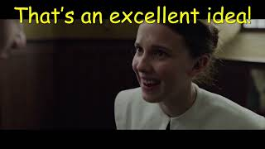
Example 2 - expressing an opinion
WORKSHEET (scaffolding)
FUNNY VIDEO

Slide 64
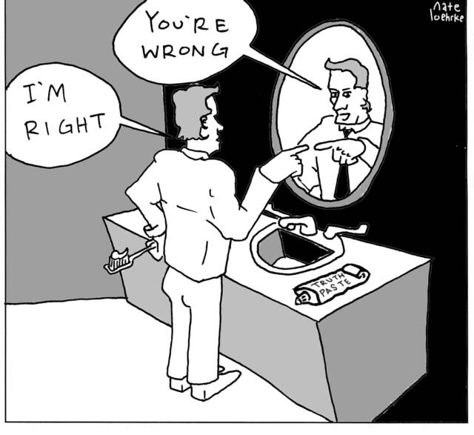
Expressing an Opinion

Slide 65
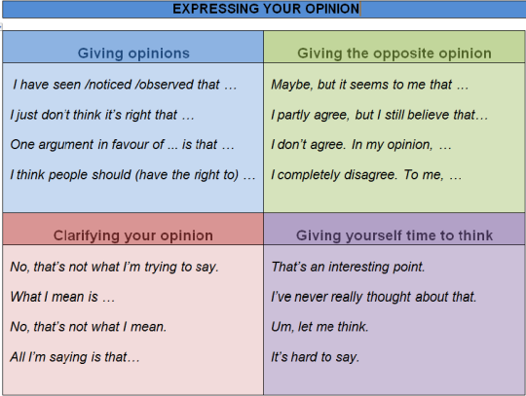

Slide 67
So, here we go! Let’s practice giving an opinion in English.
Work in pairs and decide how you feel about each statement.
You may take some notes.
Provide good arguments for your opinion.
After a few minutes, we’ll see if the rest of the class shares your opinion.
USE THE FUNCTIONAL LANGUAGE!

Slide 68
People who have mental health issues shouldn’t talk about their problems.

Slide 69
People are typically selfish.

Slide 70
Your turn
In pairs, pick a subject you feel strongly about. e.g. the environment, ‘hashtag metoo’, fashion, school rules, etc.
Come and present your ‘case’ (your opinion + arguments) to the class.
After you’ve spoken for 2 minutes (1 min / person), ask the class’ opinion. Do they agree or disagree? WHY?

Slide 71
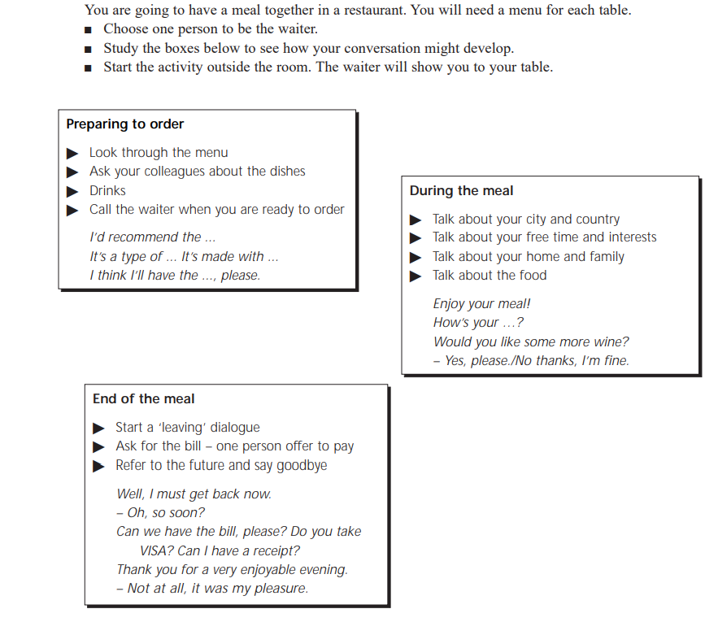
Example 3

Slide 72
Developing monologic speaking skills
When have you ever had to deliver a monologue in a foreign language? (non-academic context!)
Why are students doing this?
Who is the audience?
Argumentative speaking
Giving instructions
Narrative speaking

Slide 73
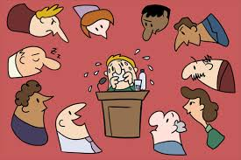
Developing monologic speaking skills: TIPS
Teach the conventions of sustained speech: structure, body language, pausing…
Plenary speaking activities or…?
Written preparations (speaking plan!), visual support
CLEAR expectations (checklist), examples, models…
Hit record ☺ … and try again…

Slide 74
Example

Slide 75
Fluency and/or accuracy?
Task-based language learning!
Don’t expect to hear every mistake that is made ☺
Anxiety to ‘get it right’ ⬄ ability to communicate

Slide 76
Teaching writing skills

Slide 78
What teachers think about writing

Slide 79
Why teach writing
Students need it nowadays: work, studies, social media…
Written interaction requires register awareness
Writing is hard: it requires many subskills (and plenty of practice!)
Awareness of what is required in a finished piece of writing
(Un)reliability of Google Translate, DeepL, ChatGPT…
…

Slide 80
Guidelines
Writing as a MEANS
vs
Writing as an END
Writing for CONTENT
vs
Writing for FORM

Slide 81
What makes writing difficult?

Slide 82
What makes writing difficult?
Students are on their own
Lack of inspiration
Red-ink syndrome
No idea how to improve
Lack of time
Students lose sight of (typically long) instructions
Students can’t use tools correctly
…

Slide 83
What makes writing difficult?

Slide 84
Guidelines for teaching writing
Collaboration IN CLASS
Element of CHOICE regarding the topic and/or the use of PROMPTS
Explicitly teach the required subskills and strategies students need
Good feedback, feed forward and feed-up
Help them to turn an instruction into a checklist
Teach them how to use tools: Spellcheckplus - Thesaurus.com – Mindmup – Canva …

Slide 85
TIMESAVING TIPS
REPETITION
BE SELECTIVE
Word count?
When do you mark? (after peer- and self-assessment!)
What do you mark? (content and/or form?) 🡪 clarify writing focus!
TECHNOLOGY as your friend

Slide 87
Writing assignment incl. AI
Write an email about your teamwork skills to your manager to apply for an open internal position.
What can you do very well?
What are your skills, what can you do better than others?
What tasks are you most suited to?
What kind of tasks are you not really suited to?
Write at least 150 words. Check grammar, spelling and punctuation.
MS Word: change the language to English!

Slide 88
Stage 1: write a personal, polite (formal) email
Stage 2: have ChatGPT or Gemini check your work:
Ask to correct your work
Ask to spell check your work
Ask to rewrite your work
Ask to expand your work
…
Stage 3: “reverse engineer”
COMPARE the computer’s work to your work: what did it do better? Which RULES for being polite did it apply?
Stage 4: Which email would you send? Why?

Slide 89
As always: differentiation
Amount of pre-teaching
Group work
Text length
Guidance on final form
Time available?

Slide 90
Mind the traps!
Writing is NOT effortless, NOT always homework
Feedback/feed forward not only after writing – avoid red pen syndrome
No readers?!
No differentiation?
Not another email…

Slide 91
WRITING ACTIVITIES (mainly for fluency)
Variation is KEY

Slide 92
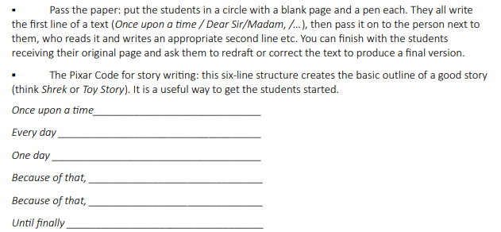
WRITING ACTIVITIES (mainly for fluency)

Slide 93
WRITING ACTIVITIES (mainly for fluency)

Slide 94
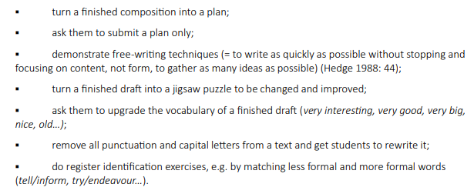
Explicitly teach subskills

Slide 95
Let’s do the Dutch reach!

Slide 97
Pre-while-post
PRE-WRITING: PREPARATION AND PLANNING
→ maximum student input: content & ideas
→ model text analysis
text purpose? reader?
WHILE WRITING
checklist!
use of tools: what is allowed/necessary/…

Slide 98
POST-WRITING
feedback, feed-up, feed forward
Peer assessment
Self-reflection
Focus on content?
Focus on form?
🡪 Revising and rewriting = essential!

Slide 99
TASK-BASED WRITING
Surveys
Telephone messages
Job applications
Complaints
…
Deep end approach ☺

Slide 100
Where to find (remedial) material?
https://learnenglishteens.britishcouncil.org/skills/writing
https://www.bbc.co.uk/bitesize/topics/z43dwnb

Slide 101
Over to you! (again)

Slide 102
Over to you!
Develop a ‘how to teach reading skills’ OR ‘how to teach listening skills’ lesson for your teacher trainees, in which you emphasise 3 things you want to remember from today’s CPD.
Use the template for easy dissemination.

Slide 103
Sharing is caring

