Slide 1
Module 2: TESOL – Day 2 August, 19-23, Antwerp Ms Nele Kempenaers

Slide 2
Getting to know each other
Hi, my name is … , I live in [city & country]
… can make my day
… is what makes me tick
I’d love to …

Slide 3
By the end of day 1 you can
See the merits of task-based learning
Identify and juggle the E-S-A building blocks
Formulate SMART learning goals
Come up with your own task-based lesson idea(s)

Slide 4
Identify the building blocks!
E = stand up
S = thinker’s pose
A = raise your hand

Slide 5
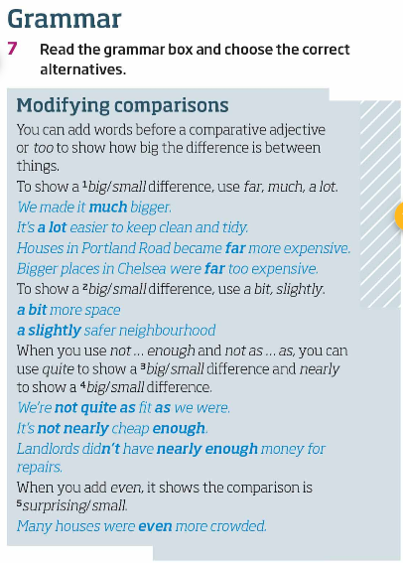
1.
Roadmap B1
E = stand up
S = thinker’s pose
A = raise your hand

Slide 6
1.
Roadmap B1
E = stand up
S = thinker’s pose
A = raise your hand

Slide 7
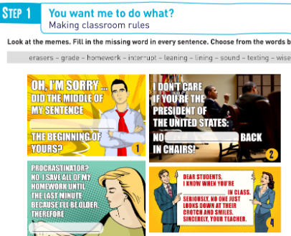
2.
Track ‘n Trace 5
E = stand up
S = thinker’s pose
A = raise your hand

Slide 8
2.
Track ‘n Trace 5
E = stand up
S = thinker’s pose
A = raise your hand

Slide 9
3.
Roadmap B1
Work in pairs. Look at and compare the photos. Also compare them to where you live.
The flat in this photo looks like mine, but I think my flat is bigger and older.
E = stand up
S = thinker’s pose
A = raise your hand

Slide 10
3.
Roadmap B1
Work in pairs. Look at and compare the photos. Also compare them to where you live.
The flat in this photo looks like mine, but I think my flat is bigger and older.
E = stand up (Task-Based Language Teaching)
S = thinker’s pose
A = raise your hand

Slide 11
4.
Track ‘n Trace 5
E = stand up
S = thinker’s pose
A = raise your hand

Slide 12
4.
Track ‘n Trace 5
E = stand up
S = thinker’s pose
A = raise your hand

Slide 13
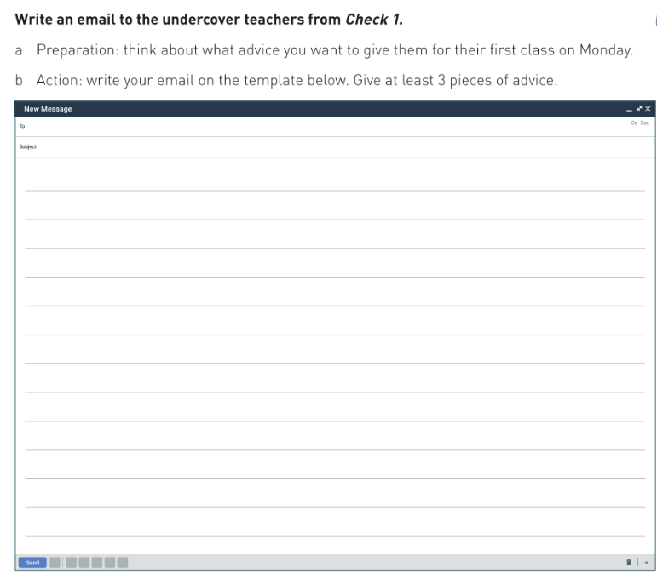
5.
Track ‘n Trace 5
E = stand up
S = thinker’s pose
A = raise your hand

Slide 14
5.
Track ‘n Trace 5
E = stand up
S = thinker’s pose
A = raise your hand

Slide 15
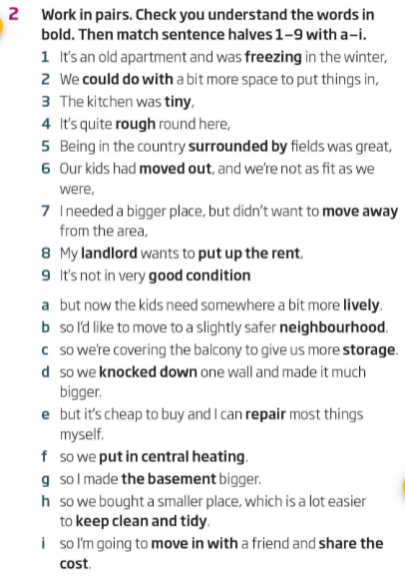
6.
Roadmap B1
E = stand up
S = thinker’s pose
A = raise your hand

Slide 16
6.
Roadmap B1
E = stand up
S = thinker’s pose
A = raise your hand

Slide 17
7.
Track ‘n Trace 5
E = stand up
S = thinker’s pose
A = raise your hand

Slide 18
7.
Track ‘n Trace 5
E = stand up
S = thinker’s pose
A = raise your hand

Slide 19
By the end of day 2 you can
See the merits of task-based learning
Identify and juggle the E-S-A building blocks
Formulate SMART learning goals
Come up with your own task-based lesson idea(s)
Teach communication skills, especially reading and listening
Increase participation and motivation in your students

Slide 20
Over to you! (30 minutes)
- design a TBL activity to make your students familiar with the concept
- what are your SMART objectives?
where do you put the different building blocks?
→ A filled in lesson plan template made by Jolien Smolders has been added to Teams

Slide 21
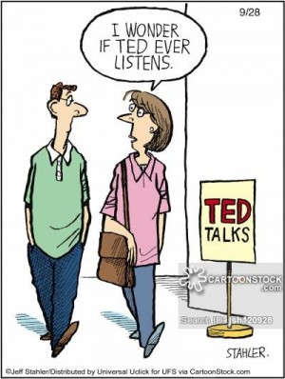
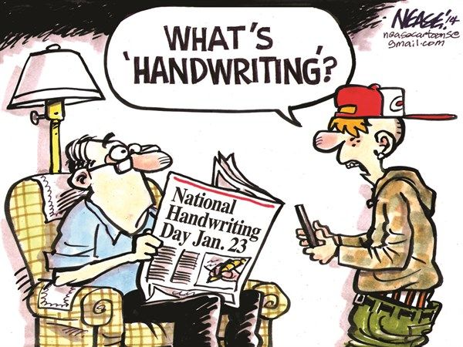
COMMUNICATIVE SKILLS

Slide 22
Pre-, while & post
Handout: check the purposes of the pre-phase.
indicate in the poll which purpose the next activities/instructions fit.

Slide 23
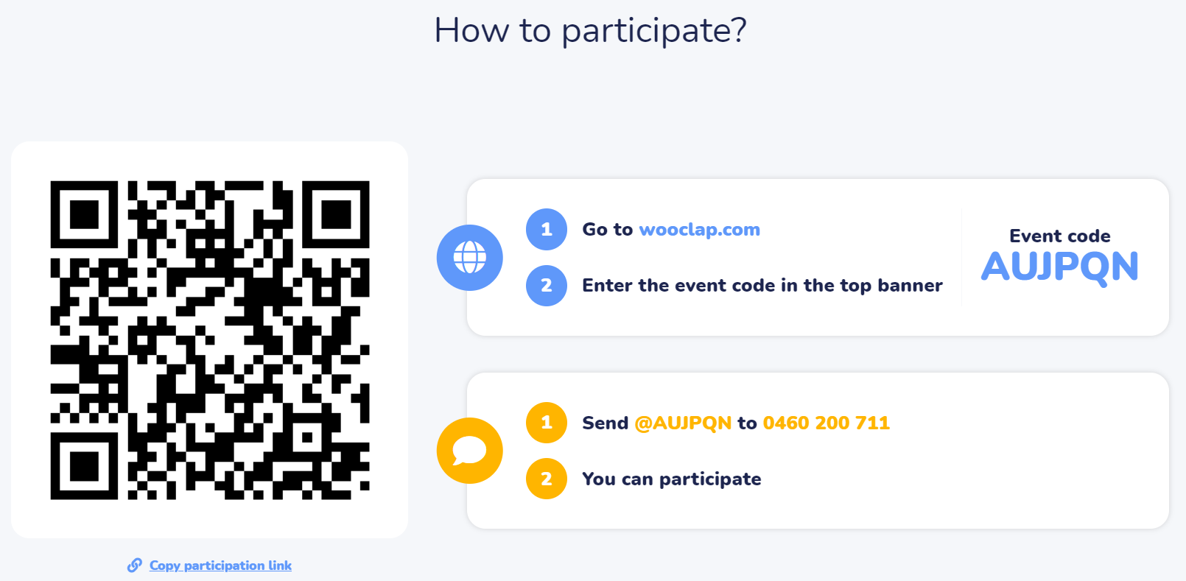

Slide 24
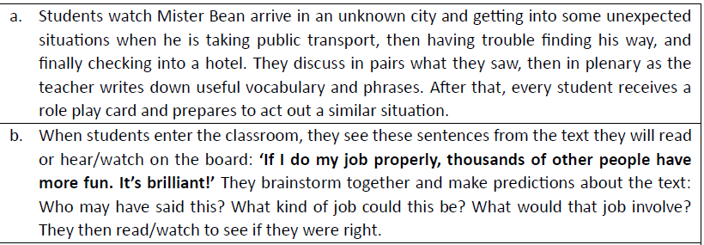
Pre-, while & post
Why would you (not) teach the same way?
What would you change?
TIME FRAME: 7’

Slide 25
Strategy use and modelling

Slide 26
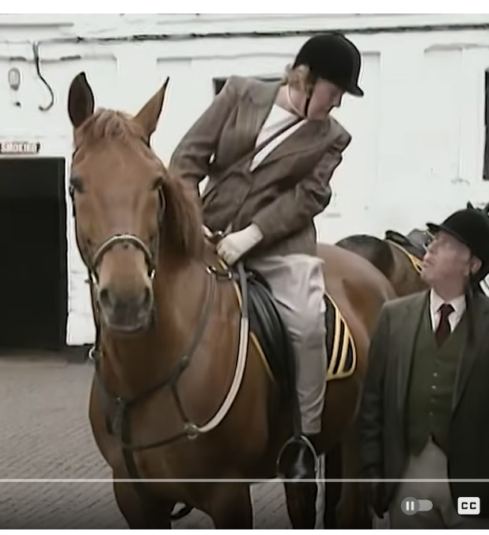
Strategy use
“Hyacinth’s most disastrous moments – Keeping Up Appearances”
https://www.youtube.com/watch?v=chvYMxi2OII

Slide 27
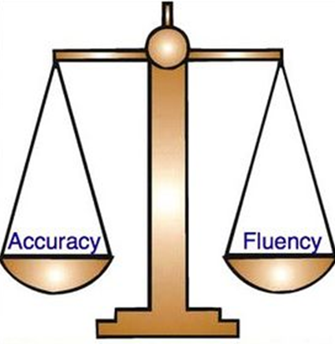
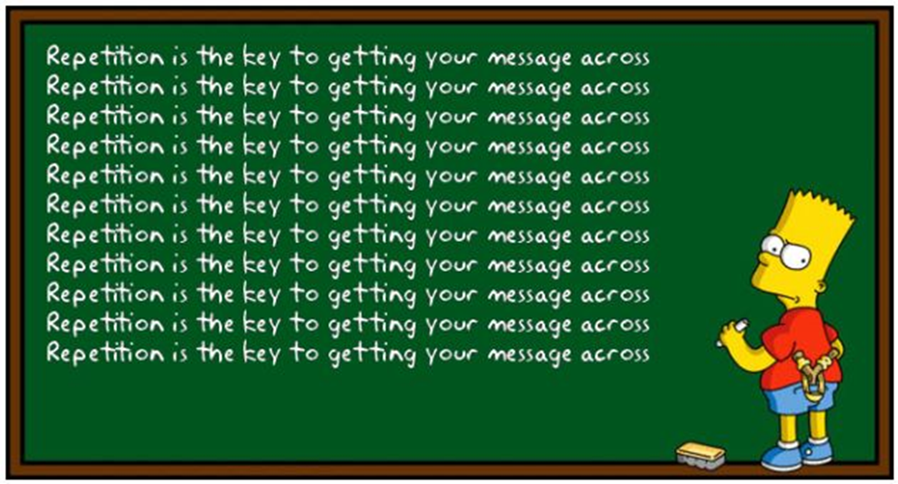
Accuracy and fluency
Fluency → get your message across
Accuracy → focus on correct language use

Slide 28
Pre-, while & post
→ What could you do after watching “Hyacinth’s most disastrous moments – Keeping Up Appearances” video? Discuss with your neighbour.

Slide 29
3. ELT building blocks
Shallow vs deep end approach to learning: home reading
Questions for reflection:
Notes:
29

Slide 30
Participation & motivation

Slide 31
What do you notice?
What do you notice when you watch these students?
Compare with a partner and discuss what could be the causes.
TIMEFRAME = 5 minutes

Slide 32
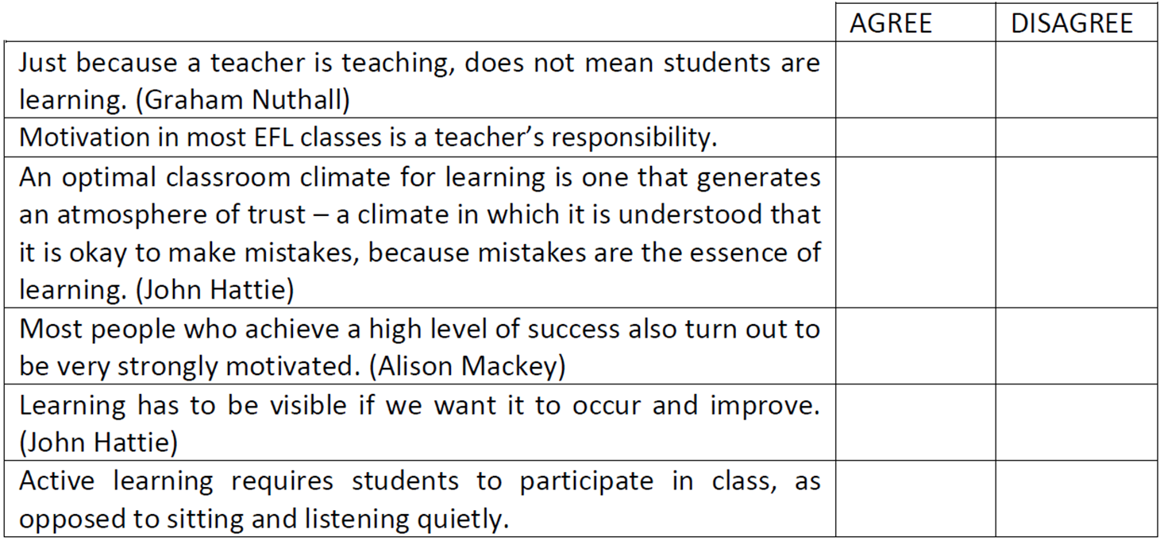
Your opinion

Slide 33
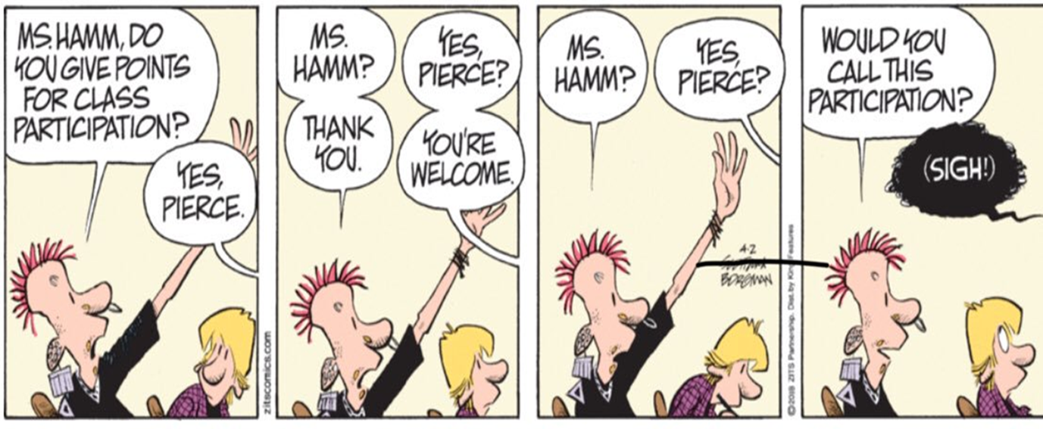

Slide 34
Participation
Provide a safe learning environment:
building a connection
positive remarks and feedback
Engage your students:
spark interest: topic, learning content, goals
how can you tell your students are engaged?

Slide 35
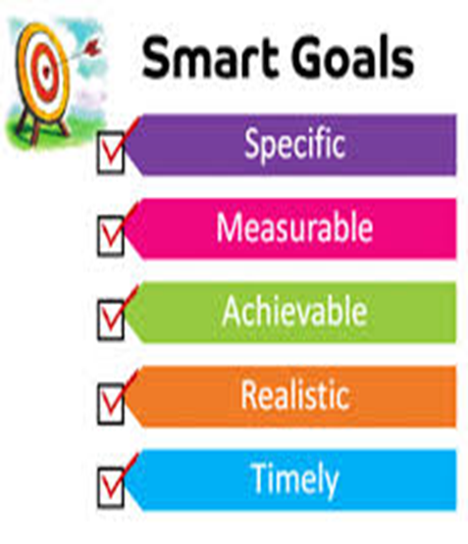
Participation
Communicate SMART learning goals
Why do we need to study this?
TBLT
Choose good lesson materials
Use suitable teaching methods

Slide 36
Time for action!
Check the participation lesson ideas
Discuss with your group members how these ideas improve student participation
Pick a group favourite ☺

Slide 37
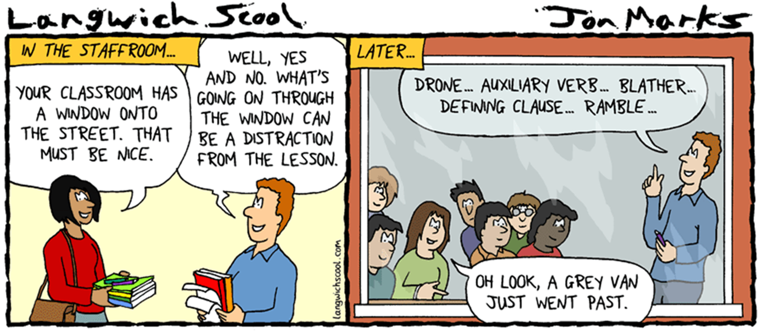

Slide 38
INCREASE PARTICIPATION
Personalisation
Self-expression
Creative (new) language use
Choice
Get ‘em moving

Slide 39
TIPS ‘n TRICKS
Competition
Pictures / video clips
Student responsibility
Organisation
Address the whole class
Rewards
Visual aids
Measurable success

Slide 40
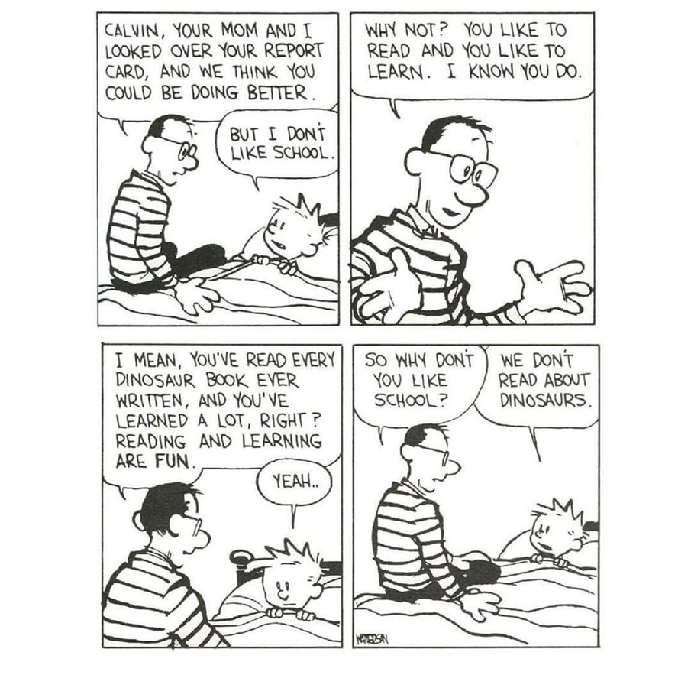
MOTIVATION

Slide 41
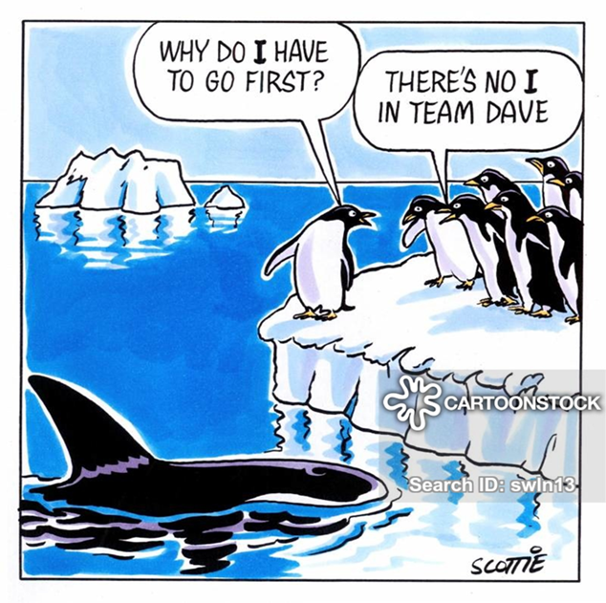
How?
Collaboration and cooperative learning
Sense of achievement
A means to an end
Fun challenge
Incomplete pattern

Slide 42
How?
Confidence and positivity
Feasibility
Growth mindset
No unfinished business

Slide 43
Time for action!
Check the motivation lesson ideas. Discuss with your group members how these ideas improve student motivation
Pick a group favourite ☺

Slide 44
Over to you! (write down ideas)
- How do you train your teacher trainees to learn how to motivate their pupils / how to make them participate?
How are you teaching them to teach reading? How does that differ from what you have heard today?
How are you teaching them to teach listening? How does that differ from what you have heard today?

Slide 45
Teaching listening skills

Slide 46
Let’s do the Dutch reach!
https://www.youtube.com/watch?v=WeM984dk220

Slide 47
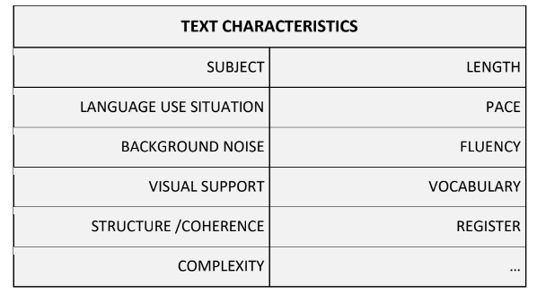
Exploration assignment

Slide 48
Reasons for teaching listening?
to explore different varieties and accents
to realize the value of listening
to acquire language subconsciously
to learn to listen for a variety of purposes
to practise an academic skill

Slide 49
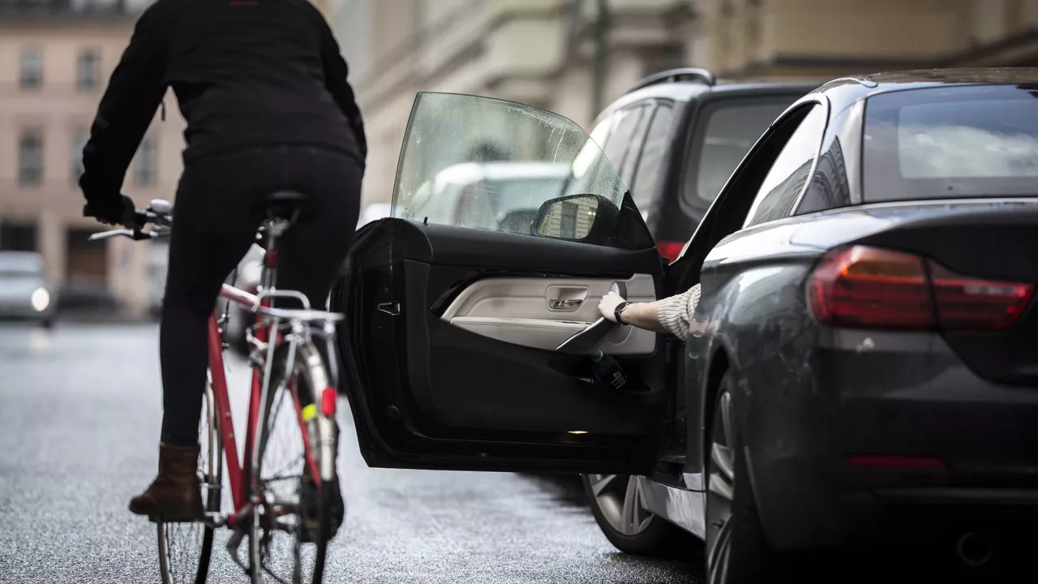
Let’s do the Dutch reach!

Slide 50
Let’s do the Dutch reach!
How do you open the car door when you get out of the car?
Do you always check for other traffic users/obstacles?
Have you ever cycled into an opening car door?
What happens to the cyclist when a car door suddenly opens?

Slide 51
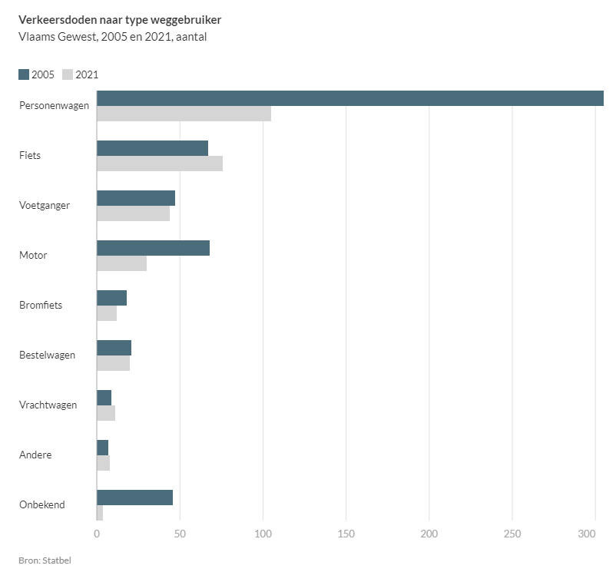
Let’s do the Dutch reach!

Slide 53
Guidelines for teaching listening
Tips and tricks:
promote student interaction
differentiation
listening rounds
video vs audio
pre, while and post
vary listening activities

Slide 55
Listening rounds
Round 1
main information
one specific piece of information
Subsequent rounds
more specific information
specific language
listening strategies: using context to understand etc.
Always from GLOBAL to SPECIFIC.
Never listen with the transcript in the first round!

Slide 56
Pre-while-post
Pre
→ maximum student input
→ predictions
→ ? essential vocabulary?
While
→ all kinds of questions
→ NOT TOO MUCH WRITING
Post
→ student interaction with text materials and each other, reflection

Slide 57
Question types
Listening for gist
→ 1 question!
e.g. Where do these friends decide to go this evening?
e.g. What is the speaker’s main aim? A) to inform; B) to describe; C) to convince
e.g. Put these 4 points of discussion in the correct order.

Slide 58
Question types
Listening for specific information
True/false/NIT - MCQ - Yes/NO - Fill in the blanks…
→ Complete the table with the missing numbers.
→ Listen for these numbers. Write down what they refer to.
→ Write notes about each of these main points: how stars are made, the sun, the Milky Way…

Slide 59
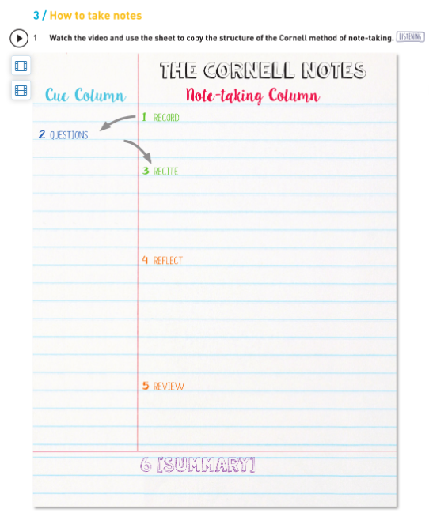
Track ‘n Trace 6, p83

Slide 60
Question types
Listening for specific (functional) language
→ Tick the phrase(s) you hear.
→ Write the phrase you hear.
Gap-filling:
limit the number of gaps / the amount of writing
provide enough words before the gap
? let students predict/guess first?

Slide 61
Track ‘n Trace 6 p185

Slide 62
Where to find (remedial) material?
https://edpuzzle.com: collection of interactive video lessons
https://engelsklaslokaal.nl/kijk-en-luistervaardigheid-engels/: TED talks with questions
https://www.youtube.com/asapscience The channel produces weekly videos that touch on many different topics of science. Fun, fast, nice visuals.
https://www.vrt.be/vrtnws/en/ The vrt news in English.
https://www.bbc.co.uk/learningenglish/english/features/6-minute-english 6 minute podcasts + useful vocabulary on the topic. Remedial exercises.
https://www.cristinacabal.com/?p=9147: 10 Best Free Listening Websites with Quizzes to Practise for Listening Exams

Slide 63
Teaching reading

Slide 64
Introduction
Practising vs teaching
→ Awareness of HOW
Take the quiz on Blackboard!
https://www.tefl.net/quizzes/teaching-reading.php

Slide 65
Reading skills
The process of reading: constructing meaning for a reason
Developing reading skills: strategies
scanning vs skimming
extensive vs intensive reading
Questions to help reach a depth of understanding (Broughton) p40

Slide 66
1. Scanning
specific information, details
ALL levels of proficiency
How?
set a time limit
‘find the names / dates / departure time / location / …’
‘find the sentence with the word … in it’

Slide 67
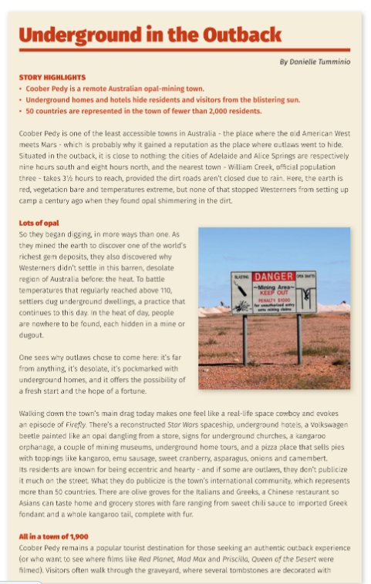
Answer these questions within 5 minutes
1.Which continent is it?
2.What are the dangers?
3.How many inhabitants are there?
4.What is the temperature?
5.What is special about the homes?
6.What do they mine?
7.What is fossicking?
8.How can you get there?
9.EXTRA: What is the fastest and safest way to get there?
(On Track 6, p15-17)

Slide 68
2. Skimming (reading for gist)
main ideas
ALL levels of proficiency
How?
Which type of text is this?
Add a subtitle for each paragraph.
‘Find the sentence that tells us that …’
‘Summarise the text in your own words in 1 minute / 5 sentences’

Slide 69
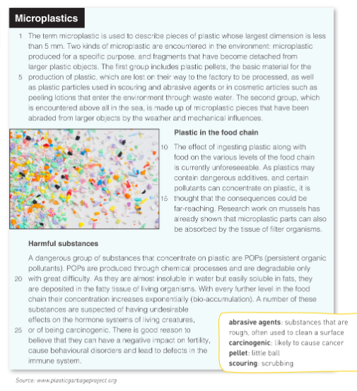
Are microplastics a threat to our planet?
Highlight in the text where you found
the answer.
What are microplastics?
Look for the topic sentence in each paragraph. Where is it usually situated?
(Track ‘n Trace 5, p136-137)

Slide 70
3. Extensive reading
for pleasure
mostly for (pre-)intermediate - advanced learners
How?
WH-questions: who, what, when, where, why, how?
see also: Teaching literature

Slide 71
4. Intensive reading
for detailed comprehension
upper levels of comprehension/proficiency
How?
Why did the author use…?
Which elements are typical of …?
Respond to the author’s point of view…
Continue the story…
….

Slide 72
Staging a reading lesson
TYPICALLY:
Pre-reading: activate knowledge, trigger an interest, purpose
While-reading: questions/strategies
Post-reading: (self-)reflection on reading process/text content

Slide 73
Staging a reading lesson
? Diving in at the deep end?
→ define your own reading goal, strategies etc. is a valuable skill
ALWAYS
set a timeline
provide an activity to be done when ready (DIFFERENTIATION)
have a follow-up activity

Slide 74
Reasons for teaching reading?
academic, professional and/or business needs
helps language acquisition
helps writing skills
inspiration for free communication
…

Slide 75
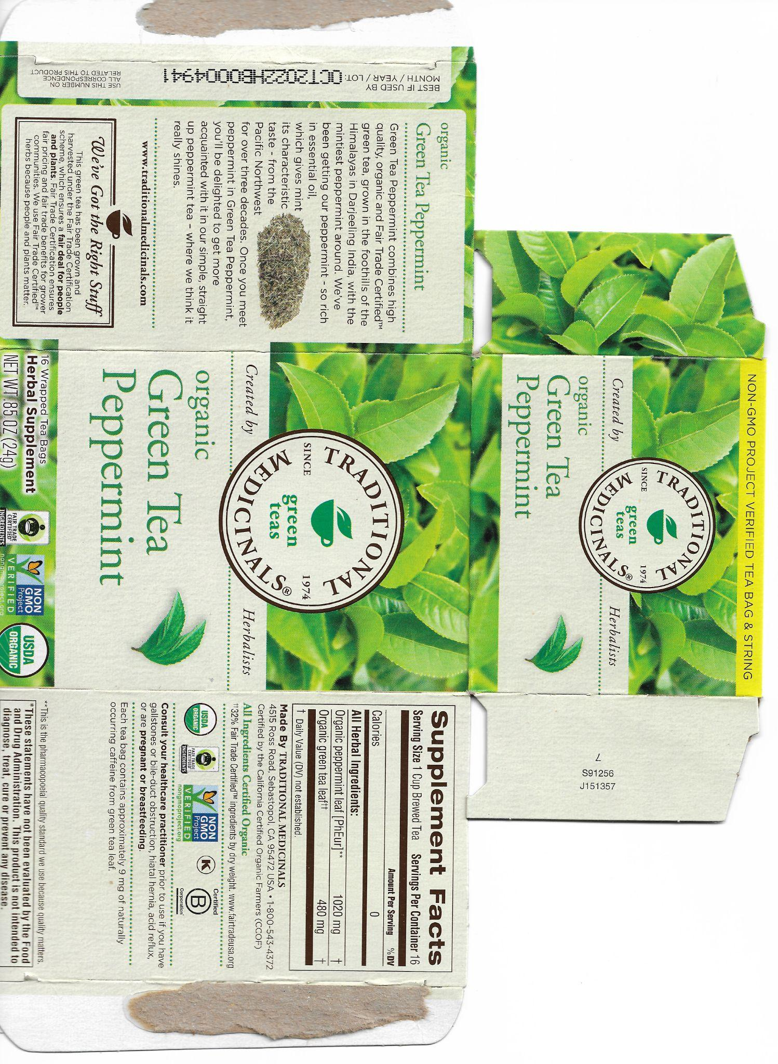
Materials for reading

Slide 76
Materials for reading
Select carefully:
different text types
authentic reading materials
relevant reading materials
Internet = treasure trove! graphs, signs, recipes, timetables…
TIP: Online quizzes/surveys/tutorials/… are motivating & instructive ;)

Slide 77
Making texts reader-friendly

Slide 78
Making texts reader-friendly
NO:
students do not need to understand everything
adapt your questions, not the text
a challenge is healthy
groupwork? jigsaw reading?
…
Mind the Zone of Proximal Development, though: CEFR Text Inspector (BB)
More than 5 incomprehensible words per page is demotivating…

Slide 79
Making texts reader-friendly
YES:
UDL: make the text more accessible
students need to understand most of it
too much of a challenge is demotivating
ADAPT PRESENTATION
font, size, pictures, line numbers, spacing…
ADAPT CONTENT
delete, substitute, rewrite

Slide 80
ADD
glossary
vocabulary list
? Which words? → CEFR vocabulary profiler (BB)
Pre-teach vocabulary?

Slide 81
ETpedia Materials Writing p69

Slide 82
Making texts reader-friendly
VARIATION is key

Slide 83
Over to you! (again)
How are you teaching your teacher trainees to teach reading? How does that differ from what you have heard today?
How are you teaching them to teach listening? How does that differ from what you have heard today?

Slide 84
Over to you!
Develop a ‘how to teach reading skills’ OR ‘how to teach listening skills’ lesson for your teacher trainees, in which you emphasise 3 things you want to remember from today’s CPD.
Use the template for easy dissemination.

Slide 85
Sharing is caring

