Slide 1
Module 2: TESOL – Day 1 August, 19-23, Antwerp Ms Nele Kempenaers

Slide 2
Getting to know each other
Hi, my name is … , I live in [city & country]
… can make my day
… is what makes me tick
I’d love to …

Slide 3
By the end of today you can
See the merits of task-based learning
Identify and juggle the E-S-A building blocks
Formulate SMART learning goals
Come up with your own task-based lesson idea(s)

Slide 4
Welcome to Antwerp!
Situation: you are in Antwerp for the week, with evenings and a Thursday off. You want to do ‘a tourist thing’ together that you will all enjoy!
Check the map of Antwerp, consult https://visit.antwerpen.be/en
Pitch your idea to the group: what is it? Why did you choose this? How long will it take? How much does it cost? When can you do this? (max 2 minutes)
TIMING: 15’
Work in pairs
Notes:
Maps of Antwerp
Draft paper

Slide 5
Present your choice:
- What is it?
- Why did you choose this?
- How long will it take?
- How much does it cost?
- When can you do this?
(max 2 minutes)

Slide 6
Welcome to Antwerp!
Situation: you are in Antwerp for the week, with evenings and a Thursday off. You want to do ‘a tourist thing’ together that you will all enjoy!
What is the best way to find out what you will all enjoy?
Survey?
Vote?
… and the winner is…
Notes:
Maps of Antwerp
Draft paper

Slide 7
What is Task-Based Learning (TBL)?
Learner motivation is enhanced by challenging tasks before studying (if necessary).
‘the emphasis is on the task rather than the language. […] When they have completed the task […], we can then, if necessary – and only if necessary – give them a bit of language study to clear up some of the problems they encountered while completing the task.’ (Harmer 1999: 31)

Slide 8
TBL principles (Ellis, 2003)
activity focus is on meaning, i.e. learners encode/decode messages, no grammar or vocabulary drilling;
communicative/information gap (e.g., learners need to ask for/find information they do not have (= gap) or need to express their opinion);
learners draw on their own (linguistic/non-linguistic) resources to complete tasks. They are not ‘taught’ the language nor the form to use to complete the task but are free to choose their ‘means’ (although they could, e.g., borrow from the input, use dictionaries/online resources, ask the teacher);
clearly defined outcome other than mere language use (e.g., poster, form, handout, opinion, reaching a compromise in discussions). While ‘performing a task, learners are not primarily concerned with using the language correctly but rather achieving the goal stipulated within the task’.

Slide 9
Welcome to Antwerp! – TBL analysis
Which of the principles of TBL are present in the exercise that you did?
Which ‘study’-input would intermediate students require in order to complete this exercise? (vocabulary, grammar, pronunciation, strategies…)
What are the merits of this approach? What are pitfalls?
Which approach is used/taught more often in your context? PPP or TBL?
Notes:
Maps of Antwerp
Draft paper

Slide 10
SMART lesson objectives

Slide 11
Welcome to Antwerp! – lesson objectives?
Which lesson objectives can you distill from the ‘welcome to Antwerp’ lesson? How would you formulate those?
Notes:
Maps of Antwerp
Draft paper

Slide 12
Welcome to Antwerp! – lesson objectives?
Notes:
Maps of Antwerp
Draft paper

Slide 13
SMART lesson objectives
Specific – Measurable – Achievable – Realistic – Timely
They should be manageable and attainable: ‘by the end of this lesson (series), you will be able to…’ Ideally you (at least) refer back to them at the end of the lesson (series) so that students can see for themselves what they have accomplished so far.
We are learning to … / What I am looking for is …
Notes:
Maps of Antwerp
Draft paper

Slide 14
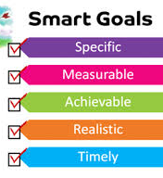
Clear learning objectives help teachers stay focused on what and how they teach, and help students monitor their own learning.
All4Ed

Slide 15
Building blocks
Students are engaged when they are involved in their work,
persist despite challenges and obstacles,
and take visible delight in accomplishing their work.
(Philip Schlechty)

Slide 16
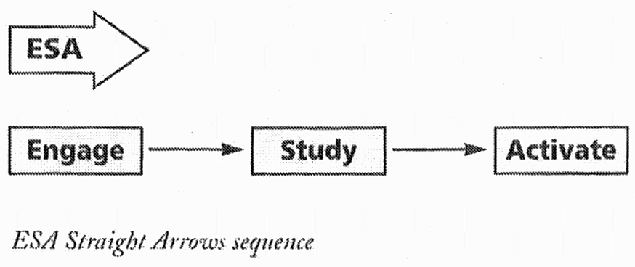
The building blocks of English language teaching
‘E’= Engage
‘S’= Study
‘A’= Activate

Slide 17
The building blocks of English language teaching
Straight Arrows (‘ESA’)
‘if we teach all our lessons like this, we may not be giving our students’ own learning styles a fair chance. Such a procedure may work at lower levels for straightforward language, but it might not be so appropriate for more advanced learners with more complex language.’
(Harmer 1999: 27)
(≈ PPP)

Slide 18
The building blocks of English language teaching
Presentation – practice – production (‘PPP’)
Subject matter is presented before practising it. It is a suitable method for teaching elementary students.
→ Do you agree PPP is most suitable to elementary students? Why (not)?

Slide 19
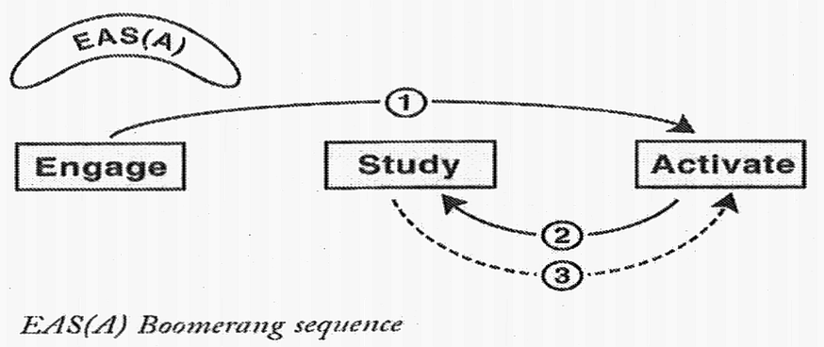
The building blocks of English language teaching
Boomerang (‘EASA’)
Creating a need for knowledge
prior to the Study phase
(= Task-Based Learning)
The teacher can let the outcome of the Activate stage decide what to study (‘Focus on Form’)

Slide 20
The building blocks of English language teaching
Task-Based Learning (TBL)
Learner motivation is enhanced by challenging tasks before studying (if necessary).
‘the emphasis is on the task rather than the language. […] When they have completed the task […], we can then, if necessary – and only if necessary – give them a bit of language study to clear up some of the problems they encountered while completing the task.’ (Harmer 1999: 31)
Notes:
taaltaken = communicative tasks geworden // paginanummer final version?

Slide 21
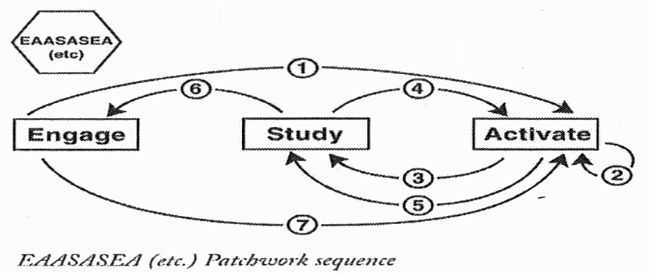
The building blocks of English language teaching
Patchwork (‘…’)
‘They provide
an appealing balance between Study and Activation, between language and topic.’ (Harmer 1999: 30)

Slide 22
The building blocks of English language teaching
Patchwork (‘…’)
→ Mimics the concept of ‘Semantic Waves’ (Legitimation Code Theory by Karl Maton)

Slide 23
Textbook inspection
Choose a Flemish English textbook, select a chapter and start your inspection.
× Which of the E-S-A building blocks correspond with each exercise/activity?
Motivate your answer.
× How engaging are the Engage activities, in your opinion? Come up with at least one alternative Engage activity.
Notes:
CRISPS meepakken!

Slide 24
3. ELT building blocks
Shallow vs deep end approach to learning: home reading
Questions for reflection:
Notes:
24

Slide 25
Over to you!
- design a TBL activity to make your students familiar with the concept
- what are your SMART objectives?
- where do you put the different building blocks?
Turn this into a real ‘lesson’ for intermediate learners.
How can you identify learners’ needs?
What makes you decide if you should interrupt or not?
What do you struggle with?

